Slide 1
Action, Caution and Hope: Three Themes for Family Medicine Chairs
John P. Franko, MD
2022 ADFM President

Slide 2
Disclosures
No Financial Disclosures.
I am a white male and I have experienced significant advantages throughout my career.

Slide 3
Objectives
Recognize
Recognize the variety and reach of the programs and initiatives in which ADFM is currently involved.
Honor
Honor Dr. Martin Luther King, Jr
Discuss
Discuss my concerns for the future
Share
Share the hope I have for the future

Slide 4
Atlanta: A Perfect Location to Discuss Equity, Diversity and Inclusion

Slide 5
Atlanta:Birthplace and Home of Dr. King

Slide 6
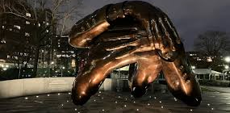
Martin Luther King, Jr.: A Small List of His Historical Accomplishments
Born January 15th, 1929
Montgomery Bus Boycott – 1955
Southern Christian Leadership Conference – 1957
Commitment to civil disobedience and nonviolent protest
Letter from Birmingham Jail – 1963
March on Washington/I Have a Dream Speech – 1963
Time Magazine “Man of the Year” - 1963
Nobel Peace Prize – 1964
Youngest person ever to receive the award, he was 35 years old
Assassinated April 4, 1968
Martin Luther King, Jr. Day established in 1983

Slide 7
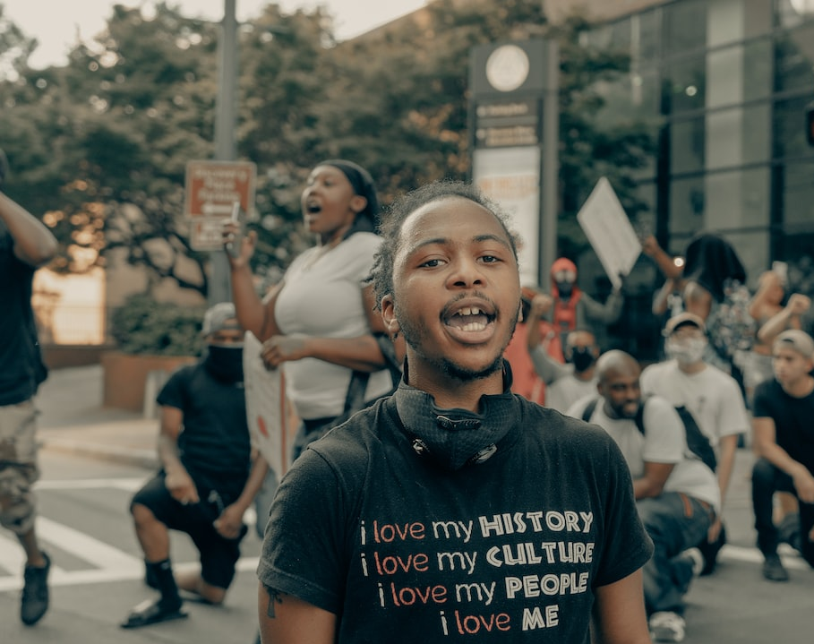
ADFM’s Attempts to Carry On His Legacy
ADFM EDI Committee
Two Conference Sessions Addressing EDI and Anti Racism
An EDI Committee Member on Each ADFM Standing Committee

Slide 8
ADFM Annual Conference 2023
Program Planning Committee – Chair Kelvin Wynn
Outstanding Speakers/Great Content
Networking Opportunities
LEADS Fellows Ignite Talks
Innovations Showcase

Slide 9
What Does ADFM Do?????
Listserv
Annual Conference
Quarterly Surveys
Other things?????

Slide 10
ADFM Board of Directors
Board Chair
President
President Elect
Treasurer
ADFM Executive Director
Administrators’ Steering Committee Chair
Administrators’ Steering Committee Chair Elect
Communications Chair
Members at Large (2)
Public Member (1)
Standing Committee Chairs (9)
AAMC Organization of Resident Representatives (ORR) (2) – ad hoc guests

Slide 11
ADFM Committees
Advocacy
Conference Planning
Diversity, Inclusion and Health Equity
Education
Healthcare Delivery Transformation
Leader Development
Nominations
Membership
Research Development

Slide 12
ADFM Membership and/or Representatives to Other Organizations
Council on Academic Family Medicine (CAFM)
Family Medicine Leadership Council (FMLC)
AAMC Council of Faculty and Academic Societies (CFAS)
Academic Family Medicine Advocacy Committee (AFMAC)
World Organization of Family Doctors (WONCA)
AAFP Commission on Education
Annals of Family Medicine
Center for the History of Family Medicine
CAFM Education Research Alliance
Program Directors Workshop Planning Committee

Slide 13
Some of the Ongoing Work
Leadership Education for Academic Development and Success (LEADS) Fellowship (106 fellows to date)
Building Research Capacity (BRC) Consults (13 full consults, 13 partial to date)
BRC Fellowship (19 fellows to date)
Research Summit (October 2023)
Residency Redesign and Competency Based Medical Education (CBME)
Multiple Webinars (Practice Transformation, Research, Education, etc)
Annual Conference Planning/ Presentations
New/Interim Chair Support

Slide 14
How Does the Work Get Done?

Slide 15
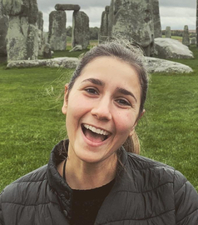
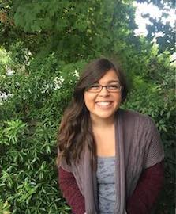
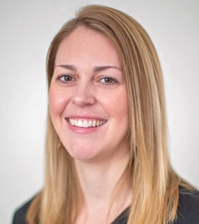
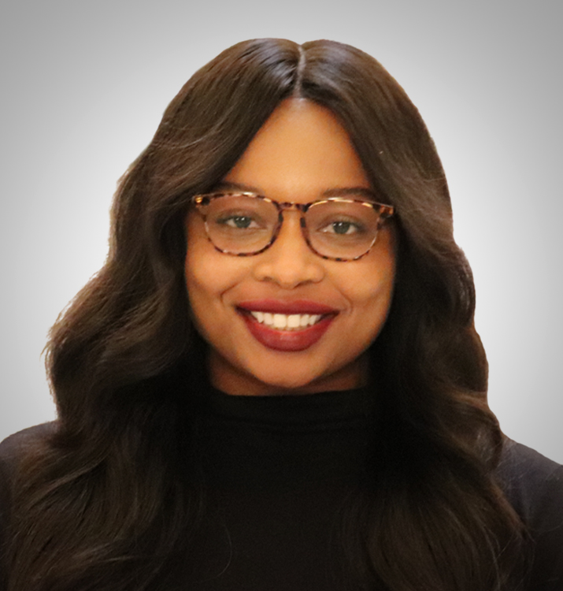
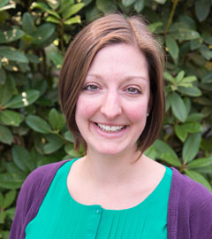
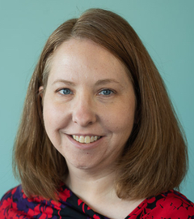
ADFM Staff
Amanda Weidner – Executive Director
Samantha Elwood – Project and Data Manager
Jessie Vera – Prog & Communication Coordinator
Melissa Abuel – Manager of Conferences
Nina DeJonghe – Director of Government Relations
Kim Sevedge – Member Relations

Slide 16
Member Volunteers

Slide 17
What Are You Prepared To Do?
Standing Committees
Lunch Today
Look at reports
Get involved
Conference Planning Committee
Organizational Liaison
Fellowship Mentor/Content Presenter
Board of Directors
ADFM Officer

Slide 18
Some of the Key Programs for 2023: We Need Your Participation
Research Summit
Residency Redesign and Faculty Time Appeal to the ACGME
Competency Based Medical Education (CBME)
DEI: ADFM and CAFM Demographic Data Tracking

Slide 19
ADFM Chair Demographic Data
Total members in that role: | 158 |  | Goal by 2025
 |  |  | Target (+15%) |  | Strech (+20%)
 | Number | % of total | Number | % of total | Number | % of total
education/training/degrees
MD or DO | 108 | 68.35%
PhD | 0 | 0.00%
MD/DO and PhD | 4 | 2.53%
other degree/degree combinations | 42 | 26.58%
no response | 4 | 2.53%
Gender
female/woman | 58 | 36.71% | 55 | 34% | 58 | 36%
male/man | 95 | 60.13%
genderqueer/gender non-conforming | 0 | 0.00%
non-binary | 0 | 0.00%
prefer to self-describe | 0 | 0.00%
choose not to disclose | 0 | 0.00%
no response | 5 | 3.16%
Age - build in calculations for birth year?
20 and under | 0 | 0.00%
21-30 | 0 | 0.00%
31-40 | 3 | 1.90%
41-50 | 30 | 18.99%
51-60 | 60 | 37.97%
61-70 | 53 | 33.54%
over 70 | 6 | 3.80%
no response | 6 | 3.80%
Race or Ethnicity
American Indian or Alaska Native | 1 | 0.63% | 1 | 1% | 1 | 1%
Asian | 12 | 7.59%
Black or African American | 21 | 13.29% | 23 | 14% | 24 | 15%
Hispanic/Latino/of Spanish Origin | 8 | 5.06% | 6 | 4% | 6 | 4%
Middle Eastern/North African | 0 | 0.00%
Native Hawaiian/Other Pacific Islander | 1 | 0.63% | 1 | 1% | 1 | 1%
White | 114 | 72.15%
choose not to disclose | 6 | 3.80%
no response | 5 | 3.16%
Family College History
One or both of my parents (or whoever raised me) graduated from college | 100 | 63.29%
Neither of my parents (or whoever raised me) graduated from college | 33 | 20.89%
choose not to disclose | 11 | 6.96%
no response | 14 | 8.86%

Slide 20
What Keeps Me Up at Night (other than the dogs)
Corporate Approach to Medicine
Transactional with everything is monetized
Small Unit Based Accounting
Fair Market Value Dictating Compensation
The Impact of Family Physicians as Deans and in the C-Suite
WAWPTD to overcome systemic racism?
The tenor of the public discourse (Benoit Blanc)
Can we learn:
To harness the power of our communities?
CBME across 741+ residencies?
To effectively impact overuse in medicine?

Slide 21
What Gives Me Hope
The young people choosing careers in Family Medicine
The 2021 NASEM Report on High Value Primary Care
PC is the only Medical Specialty shown to improve outcomes and lower costs
Therefore, PC has intrinsic benefit beyond any financial valuation
The role Family Medicine had in battling the COVID pandemic
The Family of Family Medicine Organizations
The ABFM Foundation
ABFM CEO Dr. Warren Newton
All of you
The value of the patient-physician relationship

Slide 22
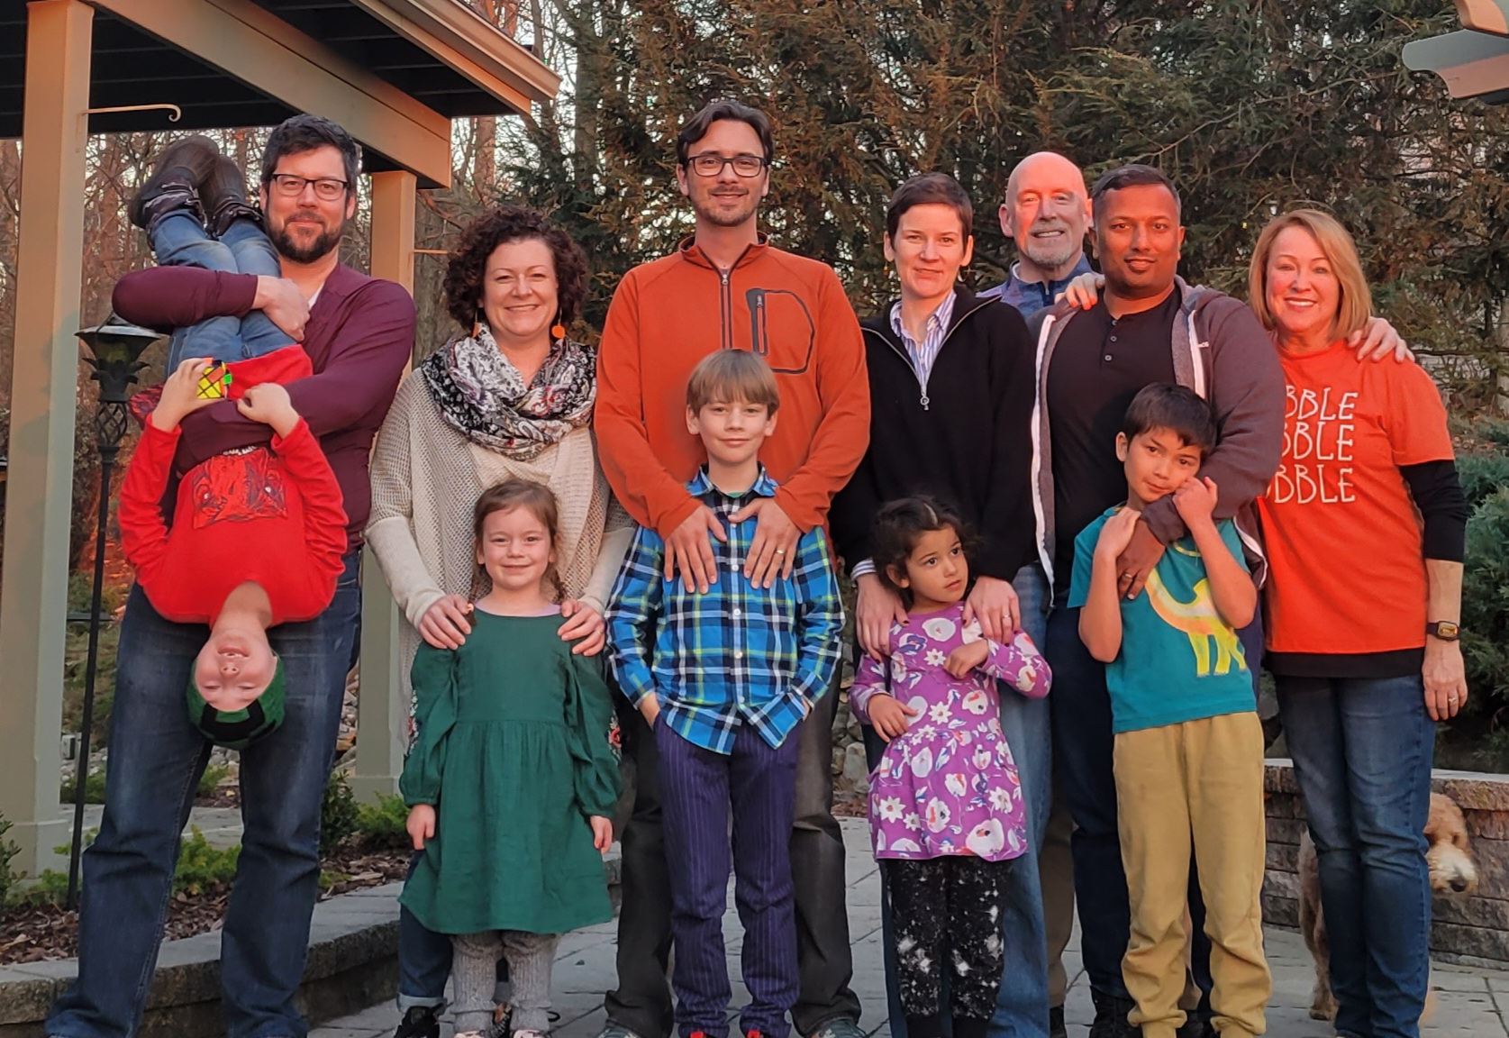
My Hope and Inspiration

Slide 23
Thank You! Questions/Comments

Slide 24
“What are you prepared to do?” Jimmy Malone “The Untouchables”
“It’s a dangerous thing to mistake speaking without thought for speaking the truth.” Benoit Blanc “The Glass Onion”

