Slide 1
Family Medicine Research Summit
Hosted by ADFM in collaboration with NAPCRG
Supported through the ABFM Foundation’s Family Medicine NEXT Initiative
Notes:
Amanda

Slide 2
THANK YOU!
A huge thank you to the ABFM Foundation for supporting this work; Warren Newton, the ADFM and NAPCRG Executive teams for their ongoing engagement and feedback into this process so far; the ADFM Research Development Committee for the many thoughtful conversations leading up to this process; and everyone else who has shared their time and wisdom with us!!
Notes:
Amanda

Slide 3
Setting the stage
2. Why? Setting the context
3. What? Vision for the process
4. Process & Summit
5. Final Product
6. FMLC Guidance
7. Next Steps
Notes:
Amanda

Slide 4
2. Why? Setting the context
3. What? Vision for the process
4. Process & Summit
5. Final Product
6. Current State
7. Innovative Inspirations
8. Next Steps
Notes:
Amanda

Slide 5
A little history
Family medicine has been grappling with its role and place as an academic discipline since its founding (Stephens, 1975)
General agreement
Family Medicine aims to improve population and community health
“A clinical discipline with academic rigor that include[s] research as a key intellectual underpinning” (Bowman 2017).
We have made progress in growing research capacity! (Weidner 2019)
Collective research efforts remain far below that of other disciplines
Extramural funding (e.g. NIH) (Cameron, 2016; Jang, 2019; Lucan, 2008) or outputs (e.g. publications) (Liaw 2019)
Stephens GG. The intellectual basis of family practice. J Fam Pract. 1975 Dec;2(6):423-8. PMID: 1230500.
Bowman MA, Lucan SC, Rosenthal TC, Mainous AG 3rd, James PA. Family Medicine Research in the United States From the late 1960s Into the Future. Fam Med. 2017;49(4):289-295.
Weidner A, Peterson LE, Mainous AG 3rd, Datta A, Ewigman B. The Current State of Research Capacity in US Family Medicine Departments. Fam Med. 2019 Feb;51(2):112-119. doi: 10.22454/FamMed.2019.180310. PMID: 30736036.
Liaw W, Petterson S, Jiang V, et al. The Scholarly Output of Faculty in Family Medicine Departments. Fam Med. 2019;51(2):103-111. https://doi.org/10.22454/FamMed.2019.536135. - Something to compare to other disciplines?
Lucan SC, Phillips RL Jr, Bazemore AW. Off the roadmap? Family medicine's grant funding and committee representation at NIH. Ann Fam Med. 2008;6(6):534-542. doi:10.1370/afm.911
Cameron BJ, Bazemore AW, Morley CP. Lost in Translation: NIH Funding for Family Medicine Research Remains Limited. J Am Board Fam Med. 2016;29(5):528-530. doi:10.3122/jabfm.2016.05.160063
Jang DH, Levy PD, Shofer FS, Sun B, Brown J. A comparative analysis of National Institutes of Health research support for emergency medicine - 2008 to 2017. Am J Emerg Med. 2019;37(10):1850-1854. doi:10.1016/j.ajem.2018.12.045
Notes:
Amanda
Counterculture
IN the community
anti-academic
To improve health and give good care, we need to use evidence - and we need to be part of the research that gets that evidence if we want it to be what our patients need
And I’ll show you a little data about our room for growth

Slide 6
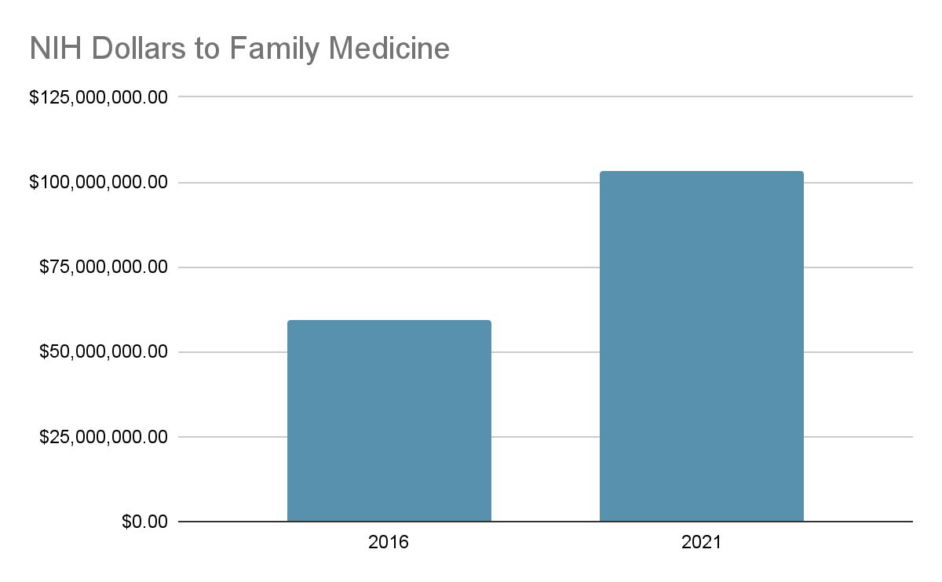
A little data
TOTAL NIH funding for all DFMs in 2021: $103M
Compared to:
Mean NIH funding for a DIM in 2021: $46M
Source: Blue Ridge Institute for Medical Research Rankings of NIH funding in 2016 & 2021
https://brimr.org/brimr-rankings-of-nih-funding-in-2021/
Notes:
Amanda – Irf chime in
Our research funding has grown in the last several years – nearly doubling NIH dollars since 2016
This is great news – nd we can see that in 2021, the TOTAL dollars to all of family medicine is twice the mean of ONE department of IM in 2021
ROOM FOR GROWTH
*in 2002, about $26M to FM
In 2007/2008ish, just under $50M
So hardly any growth 2008 to 2016
The total to DIMs in 2021: $5B
The total to DFMs in 2021: $100M
The mean to DIMs in 2021: $45M
The mean to DFMs in 2021: $2M
The median to DIM in 2021: $16M
The median to DFM in 2021: $1M
The max to a DIM in 2021: $579M
The max to a DFM in 2021: $14M
Total of 116 DIMs funded in 2021
Total of 50 DFMs funded in 2021

Slide 7
Why now?
We have some great programs!
Progress is slow
Concerning trends
Lack of physicians entering research careers in family medicine
Other groups
Emergency medicine making significant progress
Creative initiatives in other places like Canada and Europe
An opportune moment
High energy among leadership across the family medicine organizations
Unique opportunity with ADFM and NAPCRG co-hosting the FMLC meetings this year
Notes:
Amanda
There is a need to build NEW, creative strategies where every department, program, and practicing clinician can contribute in a way that is meaningful to them with an aim to grow our efforts in everything from critical appraisal to extramurally-funded research discipline-wide.
Leadership with an interest in research in key positions - is an opportune moment in the leadership of the family medicine organizations, with folks in academia currently sitting in the leadership positions of the organizations that aren’t focused on academics (e.g. Tochi Iroku-Malize as President of the AAFP; David Park, DO, as President of ACOFP)
Warren note about not enough FM researchers to populate federal health reform efforts

Slide 8
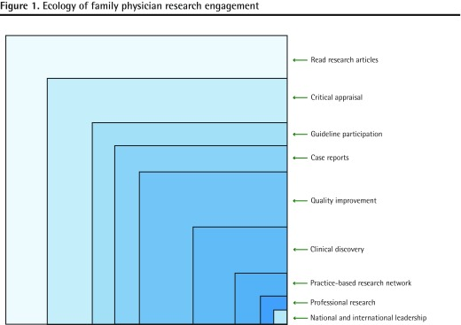
Thinking inclusively about the whole spectrum of research (practice improvement & scholarship too!)
Pimlott N, Katz A. Ecology of family physicians' research engagement. Can Fam Physician. 2016 May;62(5):385-90. PMID: 27255618; PMCID: PMC4865334.
Notes:
Amanda
“The box is not a prison, but a semipermeable membrane.” – we anticipate people moving in and out of various boxes at various points in their careers

Slide 9
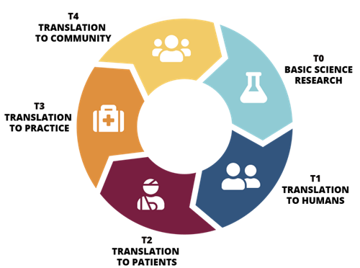
“Ecosystem connections” to meet community needs
COVID vaccine development
Population-level benefits
How to get shots in arms!
Making sure vaccine is safe
Graphic borrowed from “What is translational science” https://www.urmc.rochester.edu/clinical-translational-science-institute.aspx
Notes:
Amanda
FPs work at the interface of the community and the healthcare system
Family medicine research is any study that addresses questions of importance to FPs with the objective to improve the care of patients.
From the history (1960s into the future)
“The problems patients bring to their family physicians often exist between wellness and illness - leaving a research chasm that still exists today”
Dr. Geyman noted the general taxonomy for family practice research areas to be: 1) epidemiological and clinical research; 2) health services research; 3) behavioral research (including the impact of social changes); and 4) educational research.6
Translational science continuum
T0 - Basic Science: Preclinical and animal studies that happen at "the bench" to define molecular mechanisms and drug targets.
T1 – Translation to Humans: Clinical trials that assess the safety of a drug, device or intervention.
T2 – Translation to Patients: Clinical trials that test the efficacy of a drug, device or intervention.
T3 – Translation to Clinical Practice: Clinical trials and outcomes research that test long-term impact and cost-effectiveness of a drug, device or intervention that is already on the market.
T4 – Translation to Populations: Public health research that tests a drug, device or intervention's benefit to society.

Slide 10
Where we started this process
Thought leader interviews starting in early 2020:
NAPCRG leadership
Hope Wittenberg, CAFM Government Relations Director
Bob Phillips and Andrew Bazemore, Center for Professionalism and Value in Health Care
Warren Newton, ABFM
Christina Hester, AAFP National Research Network
Alex Krist and Chyke Doubeni regarding the Physician Scientist Pathway
ADFM Research and Development Committee
ADFM Board of Directors
NASEM Report (May 2021)
“The neglect of basic primary care research (PCR), and lack of research that draws on primary care–specific databases, such as clinical registries, not only adversely affects primary care outcomes but also leads to the lack of a population-based understanding of illness and disease along the healthcare spectrum”
“Better PCR support could lead to answers to questions that are critically important for improving population health.”
Notes:
Amanda

Slide 11
Top 10 Key Areas for Research Development
Research foci
Infrastructure
Advocacy
Funding
Pathway (pipeline)
Mentorship
Chair & Faculty development
Partnerships
Data
Communication
Notes:
Irf here down

Slide 12
And brief note that this is not new…
Mark Johnson sent us a set of slides from a presentation he did with Paul James, Charles Mouton, and Jeff Borkan in 2010 and they highlighted what it means to build research capacity (building on this 2002 article):
Linkage
Infrastructure
Training
Reputation
Publishing
Culture
Asking the Right Questions in the Right Setting
Funding
https://fammedarchives.blob.core.windows.net/imagesandpdfs/fmhub/fm2002/oct02/fd.pdf
Notes:
We looked through the specifics suggestions to build research capacity along these themes that came from this group in 2002, and it is safe to say that almost none of them have been accomplished, though we are further along in some places than others (e.g. building PBRNs, more attempts to create education about research capacity growth like BRC; more opportunities for mentorship like CERA….)

Slide 13
3. What? Vision for the process
4. Process & Summit
5. Final Product
6. Current State
7. Innovative Inspirations
8. Next Steps

Slide 14
Main outcome:
#1 Road map & strategic plan for the discipline (by 2030?)
Tracks us from current state to ideal state…
Action plan and metrics for each area
#2 - Discipline is unified on the role of each organization
How can we elevate research within each organization?
Can we write it into our strategic plans and efforts?
#3 - Everyone (students, deans, etc.): Strategic communication plan
#4 - MAYBE - NIH Center for Primary Care to amplify advocacy
#5 - MAYBE - Networks/consortia to elevate research within our discipline
Notes:
What we have done in the past has been mildly or not at all successful - thinking about new strategies
Step away from the past, envision what we want for the future - strategy and roadmap for the future

Slide 15
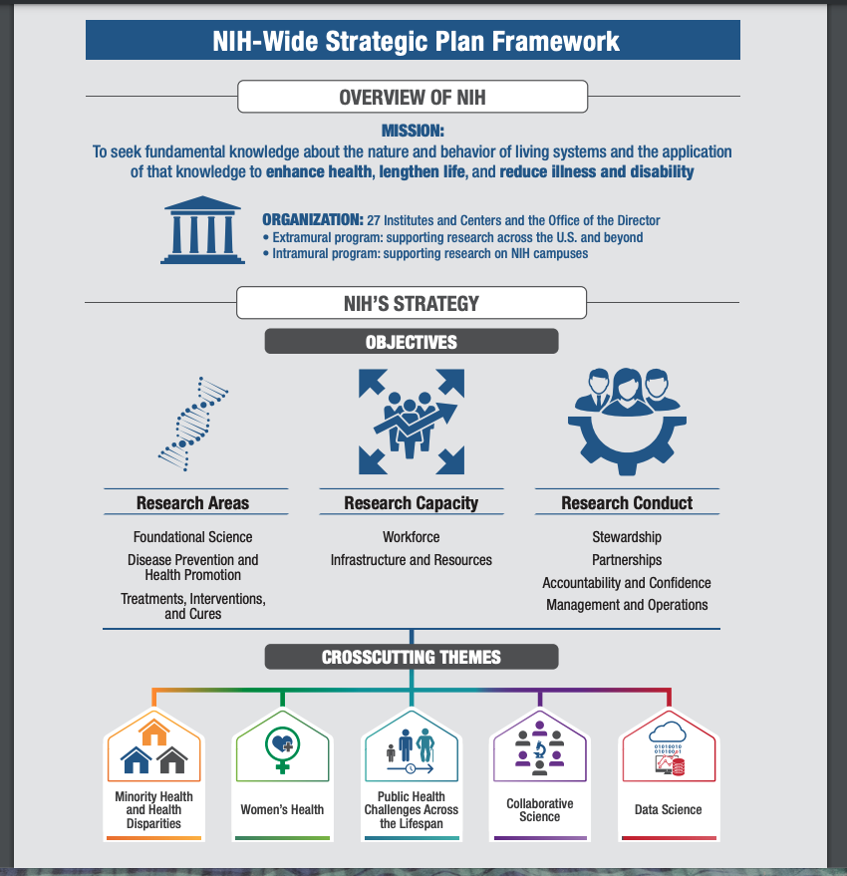
And a nice visual to help us explain the plan briefly and to broad audiences (like this)
Notes:
Make something like this!

Slide 16
4. Process & Summit
5. Final Product
6. Current State
7. Innovative Inspirations
8. Next Steps

Slide 17
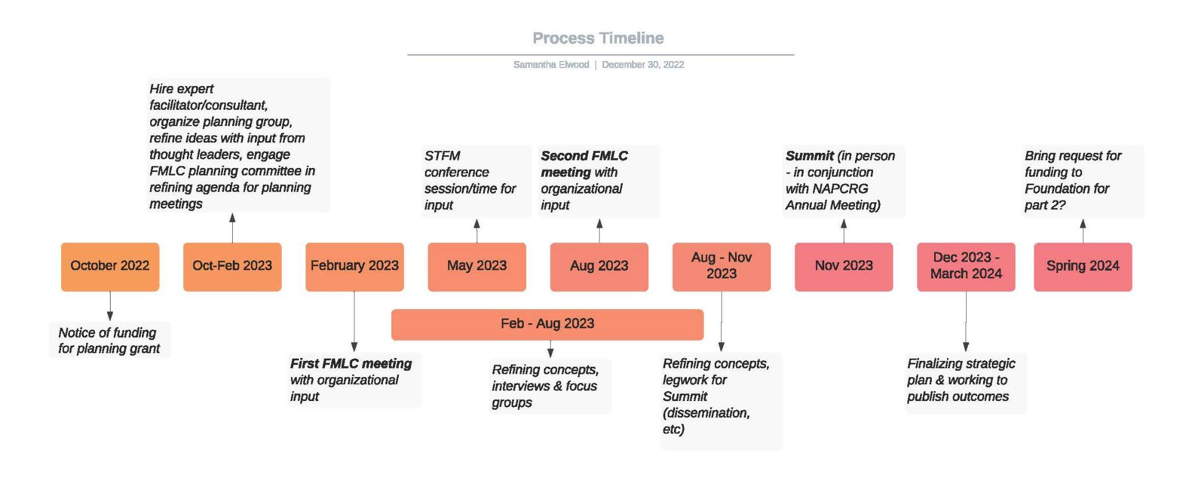
Timeline summary/overview

Slide 18
What will this information gathering look like?
Information from organizations:
Each FMLC organization to provided the following as part of their organizational updates for February 2023:
Thinking about research and research capacity building:
What has your organization done in the past (programs, grants, etc.) and what were the outcomes?
What is your organization currently doing?
If there are efforts that tie specifically to health equity, please note this.
Who from your organization (or your networks) would you recommend we engage with as part of the process of creating a strategic plan for research in the discipline?
What is the organization’s interest in/commitment to enhancing research and research capacity in the future?
do you have any goals specific to research advocacy? (if yes, please share)
2. Broad audience participation (Partner Survey): Creating Word Clouds
3. Formal focus groups and interviews
4. Series of papers

Slide 19
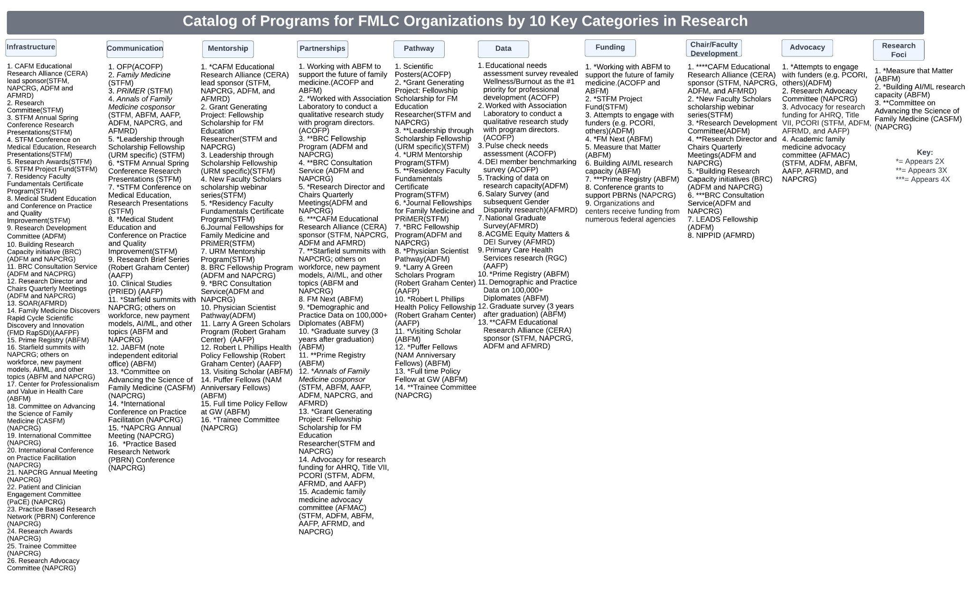
Notes:
Updated 2/21/23 - Sam

Slide 20
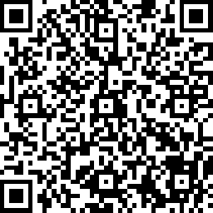
Complete the Visioning for Family Medicine Research Survey and share with others!
Use the QR code or this link to complete the survey: https://www.surveymonkey.com/r/2023researchvision
Brief survey to be shared broadly:
By 2030, what does family medicine research look like in an ideal world?
(250 words or less, think, "elevator speech")
Current barriers to achieving this ideal state
Possible solutions to these barriers
Notes:
PLEASE TWEET IT OUT

Slide 21
Key Partner Engagement
By the end of February, we’ll be finalizing names for:
Interviews (20) - goal to gather diverse perspectives with people who are intimately familiar with our discipline and research (e.g. chairs, patients, longtime researchers, a dean, etc.)
Focus groups (2 of 15 participants each) - one focused on outcomes of educational programs (PDs and learners) and one focused on research structures and experiences (chairs & research directors)
Papers (25? 30?)
Notes:
We shared this a little bit in the intro but to recap
We asked for names and have compiled these
If you have additional names, please let us know – in particular, students, residents, and patients

Slide 22
Potential paper topics…
Research foci
What are the funders looking for?
What are our journals interested in?
What are family docs interested in? (National Journal Club data)
Chair (and faculty) development
Harmonization of missions of practice (research, development of knowledge)
What to ask for in a new chair package specific to research
New methodologies (define it, teach people, build infrastructure, gather data…) - e.g. how to measure and analyze health equity; how to set up pragmatic trials
Dissemination and implementation
Partnerships
Deans and FM research?
Successful community and patient partnerships and engagement
Healthcare system disruption - CVS, Aetna, etc.
Communication
?? [??]
Advocacy
Goals of an NIH Center??
AFMAC, history and wins?
Funding
?? What is funded captured above in setting the stage?
Overall context
Setting the stage – Why? Why now? Themes
Highlighting our history and current state (context)
What is possible/innovative inspirations (EM, Netherlands MD/PhD, TUTOR PHC)
Infrastructure
Infrastructure successes and gaps - incl PBRNs, outcomes of BRC
Culture of curiosity
CERA infrastructure & outcomes to date
How do you build a center for excellence in Primary Care at your institution?
Pathways
Career pathways of physician scientists (what are the pathways? what are the entry points? how many people are there?)
Training program requirements - changes & impact; scholarship in FM residencies
Who is doing FM research? And Role of the PhD researcher
Mentorship
?? GGP?
Data
Big data

Slide 23
6. FMLC Updates & Next Steps

Slide 25
Themes from breakout discussions:
What do you hope to be true for the national family medicine research strategy by 2030?
Increased research opportunities in residency and training, accessible to all
Interprofessional approach, united vision, and broadly adopted plan
Grow, use and share data resources
Role/value-add of research and research as part of professional identity
Dedicated funding
Established research networks, centers and collaboratives
NIH Center for Primary Care Research
Widespread communication about outcomes and impact
Patient-centered approach
Research impact/results are connected to practice
High quality, innovative research that addresses the quadruple (quintuple) aim
…and that we’ve moved past this conversation by then!

Slide 26
REMINDER: Complete the Visioning for Family Medicine Research Survey and share with others!
Use the QR code or this link to complete the survey: https://www.surveymonkey.com/r/2023researchvision
Notes:
Do the survey if you haven’t done it yet
If you have done it, send it out on social media and/or to your networks
Brainstorm at your table how you can get this out more broadly (and do it)

Slide 27
Discussion questions
What topics are missing from the list of papers we are trying to generate?
How would you design a network if you were designing it from scratch? What would it look like? What resources would we need to amass as a discipline? What might be the focus of the network?
How should we communicate what we are doing once we have this strategic plan for research? What resources would we need to do that well?

