Slide 1
Building Anti-Racist Cultures through a Commitment to Racial Humility
Marissa Coleman, PsyD (she/her)
DEI Executive & Clinical Psychologist
Notes:
Share background in DEI and Psychology

Slide 2
Land & Labor Acknowledgement
We recognize that we are currently working on the historical and current homeland of the Creek and Cherokee people. We recognize the long history of genocide and land theft used to create what we know as the State of Georgia, as part of the United States of America. We commit to intentionally seeking the voices and needs of Indigenous people as one of the essential foundations of our work.
We also acknowledge the extraction of brilliance, energy, and life for labor forced upon people of African descent for more than 400 years. We celebrate the resilience and strength that all Indigenous people and descendants of Africa have shown in this country and worldwide. We carry our ancestors in us, and we are continually called to be better as we lead this work.

Slide 3
Other Acknowledgements
Frameworks and models are theories
May or may not apply to your experiences
Consider applicability to others’ experiences

Slide 4
Session Goal
The session will assist participants in creating shared language around racial humility, justice, and belonging, offer space for authentic self-reflection, and finally move attendees into a space of action as they apply principles of anti-racism into their own organizational roles.
Notes:
Review session goal with audience
We will explore the ways racial humility equips individuals and organizations to dismantle forms of oppression for all historically subjugated communities.

Slide 5
Objectives
By participating in this session, you will have the opportunity to:
Define common terms and barriers to inclusion and self reflect about how these concepts impact you, your patients, and your organizations
Discuss specific methods for mitigating bias from negatively influencing cross-cultural interactions
Explore the organizational stages of DEI and Anti-racism work and identify steps to advance anti-racism within your sphere of organizational influence.
This Photo by Unknown Author is licensed under CC BY-SA-NC
Notes:
Describe what the audience should learn from this session.

Slide 6
Agreements
Be fully present
Practice active listening
Give yourself permission to move in an uncomfortable space
Make it safe for others to take risks
It’s OK to introduce different thoughts
Practice Building on the thoughts of others
Respect the privacy of others
Value all of the voices in the room
Racism and injustice have no political affiliation
Notes:
Read all agreements and ensure audience is in agreement for this session.

Slide 7
Why it is important to center race?
Consequences of not addressing it
Transferrable frameworks and tools
America’s origins and history

Slide 8
Stop and check in with yourself… What do you notice in these three areas:
Bodily Sensations
Thoughts
Emotions/Feelings
Notes:
Through out the presentation I invite you to check in with yourself across these three domains.
Why? Our minds, bodies, and emotions/spirts are all interconnected and influence each other.

Slide 9
Part 1
The Basics of
Diversity, Equity, & Inclusion
Learning Objectives:
Review the framework for diversity, equity, and inclusion
Notes:
More of a review- creating shared language.

Slide 10
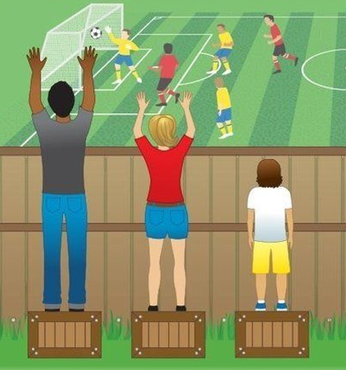
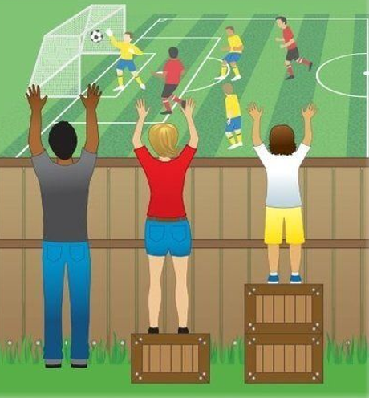
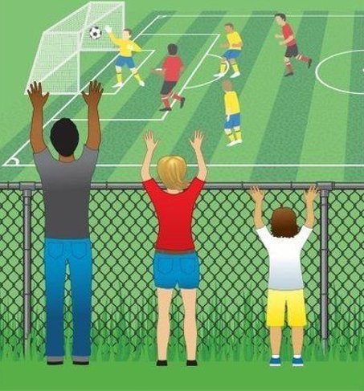
Creating a Culture of Belonging
Equality
Equity
Justice
All 3 can see the game without supports or accommodations because the cause(s) of inequity have been addressed and systemic barriers have been removed.
The assumption that everyone benefits from the same supports. This is equal treatment
Everyone gets the supports they need. Thus, producing equity
Notes:
Equity
Equity is about fairness and justice. Equity is achieved through the identification and elimination of policies, practices, attitudes, and cultural messages that create and reinforce unfair outcomes.
Although both promote fairness, equality achieves this through treating everyone the same, regardless of need and circumstances. Equity achieves this through treating people differently dependent on need, circumstance and consideration of historical and systemic inequities.
Source: Global Diversity, Equity, & Inclusion Benchmarks, 2021 Edition

Slide 11
Dimensions of Diversity
Cultural
Competition or Cooperation
Organizational
Being or Doing
Location
Management Status
Traditions
Role
Secondary
Relationship
Military
Diversity is any dimension that can be used to differentiate groups and people from one another including diverse perspectives, work experiences, lifestyles and cultures.
It includes respect for and appreciation of similarities and differences.
Geography
Primary
Tenure
Level
National Origin
Cognitive Style
Religion
Gender Identity
Ethnicity
Body Language
Time
Mental & Physical Ability
Identity
Sexual Orientation
Political
Industry
Beliefs
Race
Work Style
Network
Age
Gender
Parental status
Class
Power
Union Affiliation
Language & Accent
Appearance
Personal Space
Work Experience
Division/Department
Flexible or Structured
Individual vs team
Conflict Resolution
Source: Adapted from Workforce America! by Marilyn Loden and Judy Rosener, 1991; Diverse Teams at Work Lee Gardenswartz and Anita Rowe, 2003; and Global Diversity Puts New Spin on Lode's Diversity Wheel by Kimberley Lou and Barbara Dean
Notes:
What dimensions of diversity impact your leadership style the most?

Slide 12
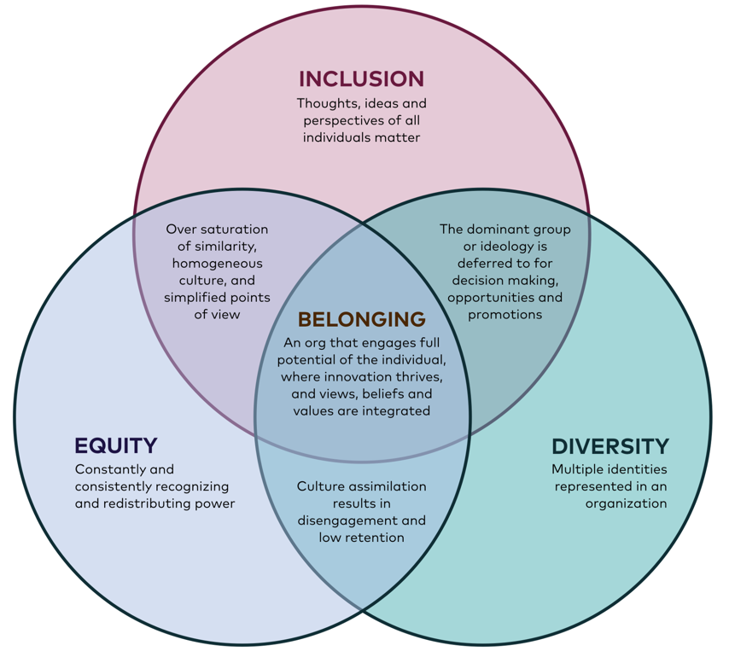
Belonging
https://medium.com/@krysburnette/its-2019-and-we-are-still-talking-about-equity-diversity-and-inclusion-dd00c9a66113

Slide 13
Part 2
Racial Identity Development
Learning Objectives:
Discuss specific methods for mitigating bias from negatively influencing cross-cultural interactions

Slide 14
Reflections: Breakout Rooms
Think back to your earliest memories of realizing you had a racial identity. Describe as much as you can about that experience.
When and how did you learn about your race?
What did this experience teach you to think about your own race?
Notes:
Small Groups

Slide 15
STAGES OF RACIAL, ETHNIC, AND CULTURAL (REC) IDENTITY DEVELOPMENT
Racial identity development theory as defined by Janet Helms (1990)
A sense of group or collective identity based on one's perception that they share a common racial heritage with a particular racial group
Racial identity development theory includes the psychological implications of racial-group membership
Belief systems that evolved in reaction to perceived differential racial-group membership.
REC Identity Development is a unique process that is often cyclical
Not every person will move through every stage within a framework
Many people may revisit different stages at different points in their lives.
Recommended Reading: “Why are all the Black Kids Sitting Together in the Cafeteria” By Dr. Beverly Tatum

Slide 16
People of Color | Multiracial People | White People
Black American Racial Identity (William Cross) | Biracial (Poston) | White Racial Identity Model (Helms)
PRE-ENCOUNTER: largely unaware of race or racial implications | PERSONAL IDENTITY: sense of self unrelated to ethnic grouping; occurs during childhood | CONTACT: In this stage, there is no conscious demonstration of racism here. Colorblind.
ENCOUNTER: forced to focus on identity as a member of a group targeted by racism | CHOICE OF GROUP: individuals feel pressured to choose one racial or ethnic group identity over another | DISINTEGRATION: In this stage, the person has new experiences which confront their prior conception of the world, the person is often plagued by feelings of guilt and shame.
IMMERSION/EMERSION: actively seek out opportunities to explore aspects of one’s own history and culture with support of peers from one’s own racial background | CATEGORIZATION: choices influenced by status of the group, parental influence, cultural knowledge, appearance | REINTEGRATION: This stage is marked by a “blame-the-victim” attitude that’s more intense than anything experienced in the contact stage.
INTERNALIZATION: secure in one’s own sense of racial identity | ENMESHMENT/ DENIAL: guilt and confusion about choosing an identity that isn’t fully expressive of all their cultural influences | PSEUDO-INDEPENDENCE: This is the first stage of positive racial identification. Although this is positive White racial identity, the person does not have a sense of how they can be both White and non-racist together.
INTERNALIZATION-COMMITMENT: comfort with one’s own race and those around them | APPRECIATION: of multiple identities INTEGRATION: sense of wholeness, integrating multiple identities | IMMERSION/EMERSION: In this stage, the person makes a genuine attempt to connect to his/her own White identity and to be anti-racist. AUTONOMY: finding a positive racial identification with being White and becoming an active anti-racist.
Notes:
Continuum of Biracial Identity Model (Kerry Ann Rockquemore and Tracey Laszloffy)
Does not seek to categorize individuals into a single identity; acknowledges continuum:
• Some people may choose to identify singularly with one of their identities;
• Some may blend with a primary emphasis on one identity and a secondary emphasis on the other
• Some may blend two (or more) identities with equal emphasis

Slide 17
Reflection Invitation
Which parts of the REC Identity Development Model match your experiences? Which do not?
How does your cultural group membership shape your worldview? (i.e., how has it impacted what you see as right or wrong, true or untrue, fair or unfair, etc.?)
How does your cultural group membership impact your interactions with others? (i.e., how does it shape the beliefs or biases you hold about others, who you feel aligned with, who you feel safe or unsafe around, etc.)

Slide 18
Multicultural Orientation
MCO - “way of being” rather than “ways of doing” guided by the person’s philosophy or values about the salience of cultural factors in the lives of individuals.
Cultural Humility - generally includes both intrapersonal (awareness of own cultural identity) and interpersonal components (awareness of cultural interactions between people).
On the intrapersonal dimension - humble individuals have an accurate view of self.
On the interpersonal dimension, humble individuals are able to maintain an interpersonal stance that is other-oriented rather than self-focused, characterized by respect for others and a lack of superiority (Hook, 2013)
Cultural Opportunity - ability to create opportunities to discuss and integrate students‘/patients’ cultural heritage into the learning process (Owen, 2013)
Cultural Comfort - comfort or ease of engaging in these discussions (Owen, 2013)
Notes:
Talking Points: Tie in clinical and admin work with patients and teams
The language of humility primes people to focus all resources within their grasp toward optimizing attentiveness and responsiveness to the client’s needs (i.e., being other-oriented), including regulation of ego involvement that might enhance self-consciousness.
Sometimes competence language—focused more on an endpoint or destination— can cause people to attend to self-presentational concerns rather than the other’s needs. (e.g. performative alleyship)

Slide 19
Microaggressions
Microassaults: Conscious, deliberate, discriminatory actions/verbal exchanges
EX. Can I have a White surgeon instead?
Microinsults: Subtle, verbal and nonverbal discriminatory actions/exchanges
EX. Calling a female doctor by her first name
Microinvalidations: A response that excludes or nullifies a person's own experiences – can be most damaging – gaslighting
Ex. I’m sure he didn’t mean it or you shouldn’t be so sensitive
Sue, D. W., Capodilupo, C. M., Torino, G. C., Bucceri, J. M., Holder, A. M. B., Nadal, K. L., & Esquilin, M. (2007). Racial microaggressions in everyday life: Implications for clinical practice. American Psychologist, 62(4), 271–286.

Slide 20
Techniques to Minimize Occurrences
Be an upstander – not a bystander – speak up
Stop, take a second look
Ask to repeat? Did I hear you correctly?
Ask for clarification – help me understand and seek clarification about comment
Talk it out
Recognize privilege and use it to uplift others

Slide 21
Part 3
Going Beyond the Script!
Theory into Action
Learning Objectives:
Explore the organizational stages of DEI and Anti-racism work and identify steps to advance anti-racism within your sphere of organizational influence.

Slide 22
Notes:
What DEI organizational stage is your org in?

Slide 23
Breakout Groups
As leaders, What steps can you commit to in order to advance the DEI evolution at your organization?

Slide 24
In a safe learning culture, people feel safe to speak up, dialogues take place about success, uncertainties, shame, fears and errors, and trainees and physicians work with compassion and empathy towards their patients, their colleagues and themselves (Stowers, et al, 2020).

Slide 25
References
Cross, W. (1991). Shades of black: Diversity in African American identity. Philadelphia: Temple University Press. 499-521.
Cross, W., Parham, T., & Helms, J. (1991). Stages of Black identity development: Nigrescence models. In R.L. Jones (Ed.) Black Psychology (3rd ed, pp. 319-338). New York: Harper & Row.
Davis, D. et. al (2018). The Multicultural Orientation Framework: A Narrative Review. Psychotherapy, 55 (1), 89-100.
Helms, J.E. (1990/1993). Toward a model of White racial identity development. In J.E. Helms (Ed.), Black and White racial identity, pp. 49-66. New York: Greenwood/Praeger.
http://www.pstcc.edu/_files/pdf/Compilation_of_Racial_Identity_Models.pdf
Stowers, J., Desrosiers, S., Zeleke, K., Bakare, O., Seifi, A. (2020). The Life of a Black Medical Trainee in the United States: Past, Present, Future. Journal of the National Medical Association. https://doi.org/10.1016/j.jnma.2020.07.004
Tatum, B. D. (2003). "Why are all the Black kids sitting together in the cafeteria?": And other conversations about race. New York: Basic Books.
http://www.pstcc.edu/_files/pdf/Compilation_of_Racial_Identity_Models.pdf

Slide 26
Thank you!
Info@drmarissacoleman.com
www.Drmarissacoleman.com

