Slide 1
Saturday, 2/25/23, 9:30 - 11:00 am ET (90 mins)
The Changing Role of a Chair and Administrator in Academic Medical Centers
Panelists:
Richard Lord, MD, Wakehealth (moderator)
Peter Nalin, MBA MD, University of Minnesota - Duluth
Tochi Iroku-Malize, MD MPH MBA, Zucker School of Medicine at Hofstra/Northwell & AAFP President
Anna Ramanathan, Administrator, Medical College of Georgia - Augusta
Anna Flattau, MD MS MSc, Jefferson
2023 ADFM Annual Conference

Slide 2
AGENDA
9:30 – 10:05 am: Presentation from panelists
Framing the issue
Zucker School of Medicine/Northwell Health
Medical College of Georgia at Augusta University
Jefferson Health/ Thomas Jefferson University
10:05 – 10:15 am: Complete poll & orient attendees to breakout prompts
10:15 – 10:45 am: Breakouts
10:45 – 11:00 am: Q&A with panel
Notes:
Situation:
The Changing Roles of the Chairs and Administrators
Why are the roles changing?
The changes arise from the changes in context of family medici.ne
What are the contexts that are changing?
The contexts of family medicine are changing in three broad arenas
1. Health system context changes
a. Health system changes, mergers, acquisitions, primary care, inpatient and outpatient
care
b. Health system finances are struggling
2. Medical education changes
a. Curricular renewals, LCME comparability and other requirements
b. Admissions, preparedness, and changing needs of medical students
c. ACGME and market reengineering of the scope of family medicine
3. Societal changes
a. Hybrid work locales
b. Recruitment, retention
c. Workforce shortages of medical personnel and all personnel
d. Imperatives to deliver upon promises of better health equity
Background:
Chair and senior leader competencies document by ADFM, comprehensive and insightful.
Acknowledges the leadership of the individual and the competencies among the leader team.
Mentions the development and management of internal and external relationships.
Assessment:
Indeed, the Roles of Chairs and Administrators are changing…
Intensity
Fluidity
Ratio of control to influence is trending toward…
Decreased control and therefore more reliance upon influence.
Recommendation:
Listen for how our panel each describe their challenges and their adaptive leadership responses.
Consider how the three categories of changes: health system, education, and societal changes
are driving the Changing Roles of the Chairs and Administrators.

Slide 3
Zucker School of Medicine/Northwell Health
Describe you institution:
> 81,000 NWH; 392 ZSOM
Private School
DOFM Faculty - 200 FM Phys; 4 FMRP (MD & DO), 90+ residents
Patients Served - FQHC, Private, Hospital Based
Annual Revenue - NWH $9B, DOFM - mixed
Academic Decisions FMSL/DOFM
Operational Decisions NWH/Regional/MSL/FMSL
Notes:
Going to give a very high level overview of some of our progress and efforts in 2021
Please see my report to the Board about 2021 progress for more detail

Slide 4
Zucker School of Medicine/Northwell Health
NWH acquired community hospitals then created the med school
12 years in existence
NWH vs ZSOM
Notes:
Going to give a very high level overview of some of our progress and efforts in 2021
Please see my report to the Board about 2021 progress for more detail

Slide 5
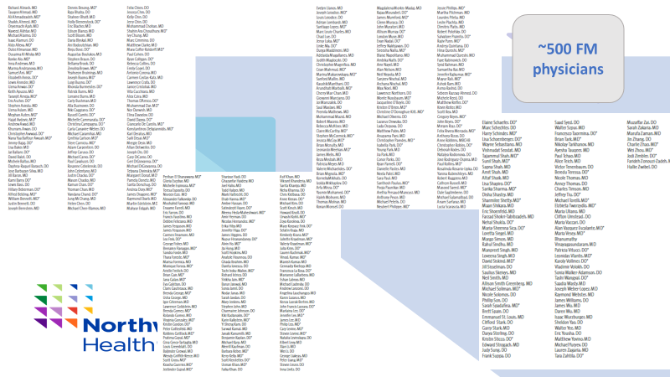
Zucker School of Medicine/Northwell Health
500 FM in Department
200 Employed by NWH
120 Faculty Appointment
Notes:
Going to give a very high level overview of some of our progress and efforts in 2021
Please see my report to the Board about 2021 progress for more detail

Slide 6
Zucker School of Medicine/Northwell Health
Population Health via division, regions and corporate
Primary care major strategy: SVP Community & Population Health
Community sites
FICC, FSL 5th, FSL Brentwood, BEST, Rego Park
Notes:
Going to give a very high level overview of some of our progress and efforts in 2021
Please see my report to the Board about 2021 progress for more detail

Slide 7
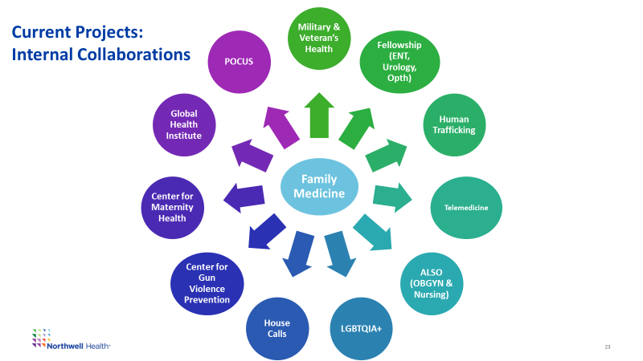
Your role
Roles & Responsibilities
Academic
FMRPs
Faculty Promotions
Research & Scholarly Activity
UME-GME-CME
Operational
Recruit, Retain
FPPE/OPPE
Strategic Planning
Areas of control and areas of influence.
Structures with interaction

Slide 8
Medical College of Georgia at Augusta University
Describe you institution:
Employee size: ~50
State or Private School: State
Faculty: 24
Patients Served: 27,000 in FY’22
Annual Revenue: $5.28M with ~ 30% payor collections rate
Speak to the decision making/administrative structures within your department - part of a service line or do they exist w/in a department of family medicine? More at a department level

Slide 9
Medical College of Georgia at Augusta University
Are you acquiring or being acquired? Letter of Intent has been presented by Wellstar to become a ‘member substitute’ for Augusta University Health System. The assets will be owned by Board of Regents. Wellstar will continue to lease the facility
How long has the medical school been part of the system? Since the inception in 1956
Do you feel any tension between the goals of your enterprise and the academic mission? Yes. But manageable with appropriate transparency and expectations management

Slide 10
Medical College of Georgia at Augusta University
Are all family physicians in your enterprise in your department? No
If they are not in your department, what structure do they live in? For faculties who are not part of the department, they are directly employed by the Practice Plan
Notes:
Going to give a very high level overview of some of our progress and efforts in 2021
Please see my report to the Board about 2021 progress for more detail

Slide 11
Medical College of Georgia at Augusta University
What roles or interaction do you have with a population health team?
We have monthly meetings to review QI metrics of interest centered around GA Medicaid Plan
What’s the system’s view of population health? Do they value it?
There is a value but centered around payor designed metrics of interest
What’s your institution's view of family medicine and primary care?
We are seen warmly as conduit for Primary Care but has opportunities for improvement
Notes:
Going to give a very high level overview of some of our progress and efforts in 2021
Please see my report to the Board about 2021 progress for more detail

Slide 12
Your role
What are your roles and responsibilities in the department and system? Administrator responsible for Departmental and Clinics Business & Operations

Slide 13
JEFFERSON HEALTH/ Thomas Jefferson University
Describe your institution:
Employee size: 40,000
State or Private School: Private
Faculty: 59
Patients Served: 600,000 (~30,000 in university FM department)
Annual Revenue: $9.7 billion ($25.5 million in university FM department)
Departmental faculty, staff, and clinical operations report to the Department. System-wide, there are 7 regions/departments (FM and IM in the university, and 5 non-academic primary care regions).
Notes:
Going to give a very high level overview of some of our progress and efforts in 2021
Please see my report to the Board about 2021 progress for more detail

Slide 14
JEFFERSON HEALTH/ Thomas Jefferson University
Are you acquiring or being acquired? Neither right now. We merged across 6 different systems in the last ~6 years.
How long has the medical school been part of the system? 200 years (the academic center acquired the other regions of the system)
Do you feel any tension between the goals of your enterprise and the academic mission? The size of our newly established Jefferson Primary Care system, and our new executive leadership that has centered primary care as a strategic priority, has positioned a historically strong department to reach new heights.
Notes:
Going to give a very high level overview of some of our progress and efforts in 2021
Please see my report to the Board about 2021 progress for more detail

Slide 15
JEFFERSON HEALTH/ Thomas Jefferson University
Are all family physicians in your enterprise in your department?If in your department, do they have a faculty appointment?
No, only faculty employed in our department report to the department. However, many of the family physicians across the enterprise have voluntary appointments, mainly because they teach medical students.
We recently established a mechanism to buy out FTE from non-academic primary care doctors to support clinical trials, and hopefully this will allow us to spread the wealth of academic activity more widely.
If they are not in your department, what structure do they live in?
They report up through geographic divisions, and hiring/operations are supported by the Medical Group.
Notes:
Going to give a very high level overview of some of our progress and efforts in 2021
Please see my report to the Board about 2021 progress for more detail

Slide 16
JEFFERSON HEALTH/ Thomas Jefferson University
What roles or interaction do you have with a population health team?
Recent changes in our organization have opened the doors to transparency and collaboration that were not previously possible.
What’s the system’s view of population health? Do they value it?
Very much. We are moving to value and are part way there. This is a priority.
What’s your institution's view of family medicine and primary care?
The academic department has always been very highly respected in the university.
With new executive leadership, almost overnight we have transformed from being the last priority to the first.
Notes:
Going to give a very high level overview of some of our progress and efforts in 2021
Please see my report to the Board about 2021 progress for more detail

Slide 17
Your role
What are your roles and responsibilities in the department and system?
Chair of Family & Community Medicine
Enterprise VP for Jefferson Primary Care
Can you describe your areas of control and areas of influence?
Department reports to me
In establishing Jefferson Primary Care, soft power is transforming to explicit power because we have created results through development of culture, governance, structure, and processes.
What structures exist outside of your department that you need to interact with and have some sort of influence?
Medical Group; Regional Divisions; University; various corporate services that we depend on to get things done (finance, strategy, HR, marketing, legal, etc.)
Notes:
Going to give a very high level overview of some of our progress and efforts in 2021
Please see my report to the Board about 2021 progress for more detail

Slide 18
Please respond to the following poll!
https://www.surveymonkey.com/r/adfmpoll

Slide 19
Breakouts
Self-reflection questions:
What did you respond to the poll with and why (ex: If you’re thinking about growing)
Pressure points in your department based on buying, being bought, haven’t started down this path
What problem have you solved for your health system in the past two years? What problems have you caused?
If you’ve been acquired, how are you surviving?

Slide 20
Wrap-up
Q&A with panel

