Slide 2
Disclosures
(positionality statement)
Post-positivist
South Carolina native
Military retiree spouse
Coca Cola
shareholder
Georgia taxpayer and employee

Slide 4
“Family physicians have no unconditional faith in science, and this marks us as belonging to the counterculture.”
Department insiders
faculty, residents, support staff, clinical staff
University insiders
medical students, physicians from other specialties, administration
Outside your walls
Community members (maybe patients), community organizations and leaders, local officials

Slide 5
“Family physicians have no unconditional faith in science, and this marks us as belonging to the counterculture.”
compliance
round
step
burnout
satisfaction
ICD
unopposed
provider
match
value-based
peer review
continuity
complaint
denies
double-booked
OSCE
preceptor

Slide 6
A strong culture…
…creates a common language…
…that builds a shared value system…
…toward a shared vision of the future.

Slide 7
Strong
Productive
Weak
Productive
Mission
Weak
Destructive
Strong
Destructive
Time

Slide 8
Key components of a strong culture
Rites and rituals
Values
Cultural communication
Heroes
Deal and Kennedy (1982)

Slide 9
Who is the author of your story?

Slide 10
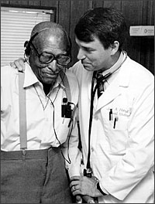
“Like you, I am a participant observer in the drama of medicine I have not seen the script, not do I know the playwright.”
-Gayle Stephens

Slide 11
What is the setting
of your story?
Narnia lamppost illustration by Pauline Baynes

Slide 12
Augusta-Richmond County (pop: 201,196 (QuickFacts Augusta-Richmond County consolidated government, Georgia)) is the 121st largest incorporated place in the U.S. (City and Town Population Totals: 2020-2021). The County has some of the best primary care physician to resident (1:900), mental health provider to resident (1:310), and dentist to resident (1:480) ratios in the state (County Health Rankings and Roadmaps, 2022). However, the state’s medical school neighbors some of the state’s unhealthiest places. According to the 2022 County Health Rankings (County Health Rankings and Roadmaps, 2022), it is ranked among the least healthy counties in Georgia (124 of 159 counties); 7.6% of residents are unemployed, 39% of people under the age of 18 live in poverty, 16% lack adequate access to food, and 20% of households have overcrowding, high housing costs, lack of kitchen facilities, or lack of plumbing facilities. The life expectancy in the county is 73.2 years (by race/ethnicity: 85.9 among Asian Americans, 84.2 among Hispanic Americans, 72.6 among Black Americans, 72.6 among White Americans. Augusta-Richmond County is 57.5% Black/African American, 35.3% White, and 5.1% Hispanic/Latino) (QuickFacts Augusta-Richmond County consolidated government, Georgia).
Augusta-Richmond County
pop: 201,196
121st largest incorporated place in the U.S
Robust health workforce
primary care physician to resident (1:900)
mental health provider to resident (1:310)
dentist to resident (1:480)
Ranked among the least healthy counties in Georgia
124 of 159 counties
39% of people under the age of 18 live in poverty
16% lack adequate access to food
20% of households have overcrowding, high housing costs, lack of kitchen facilities, or lack of plumbing facilities

Slide 13
...where the [grocery store] was torn down, now it's just [medical school] parking.
So, what the hell is that?
More bull*#^%

Slide 14
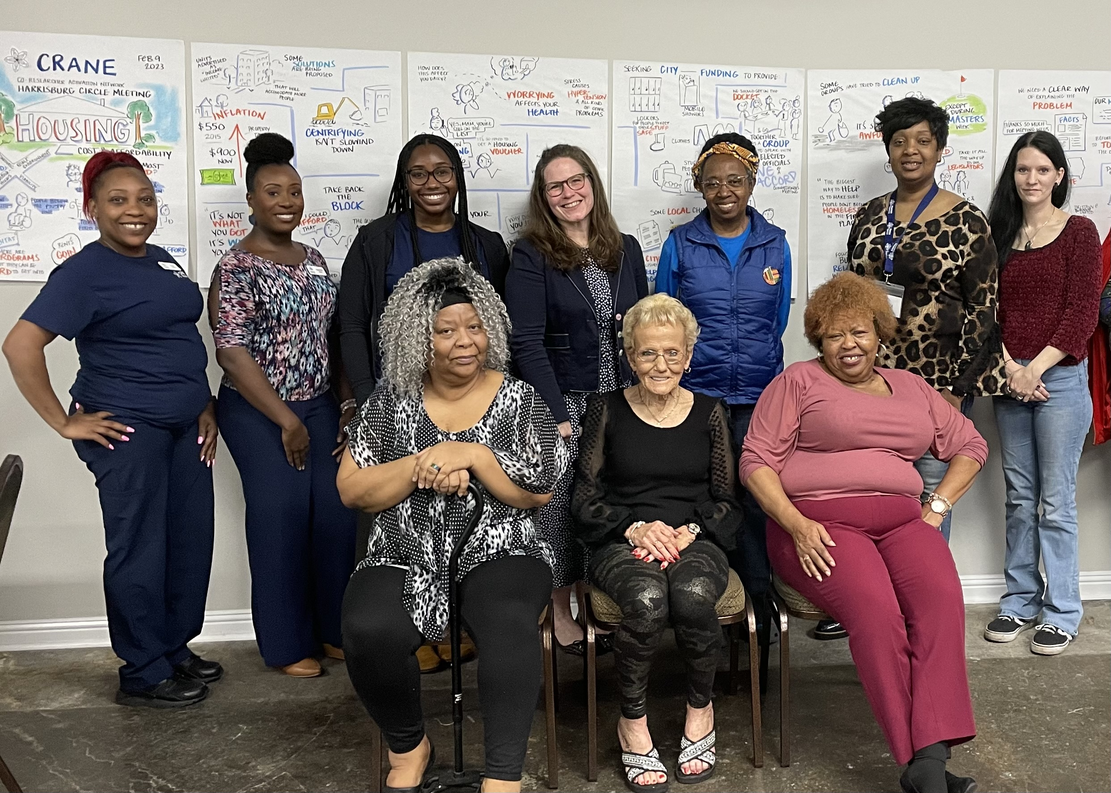

Slide 15
Who is the
hero
of your story?

Slide 17
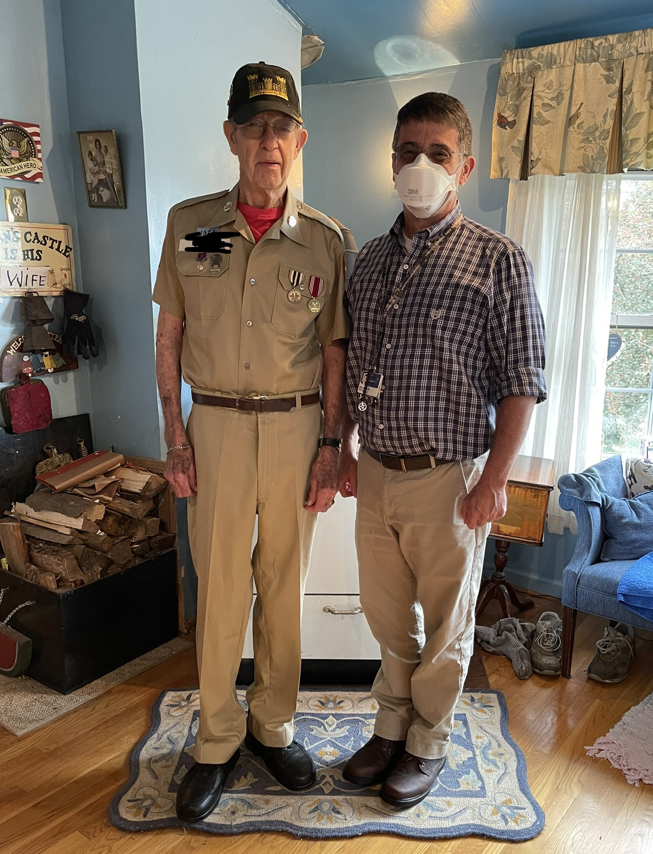
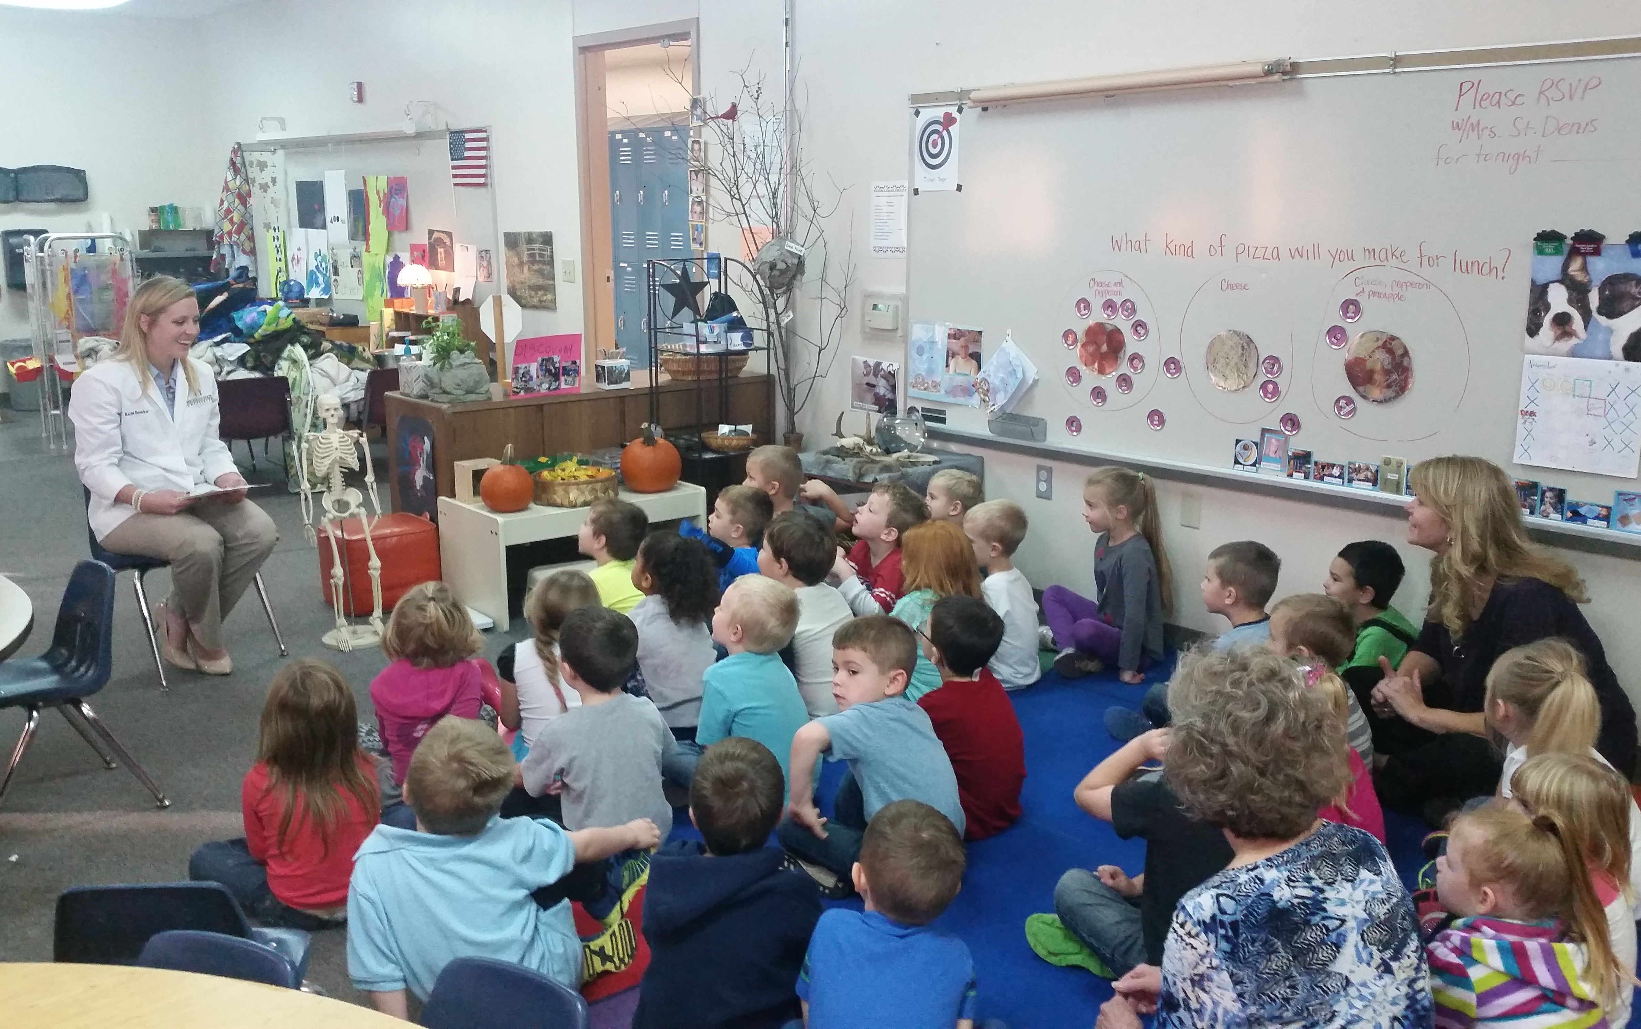
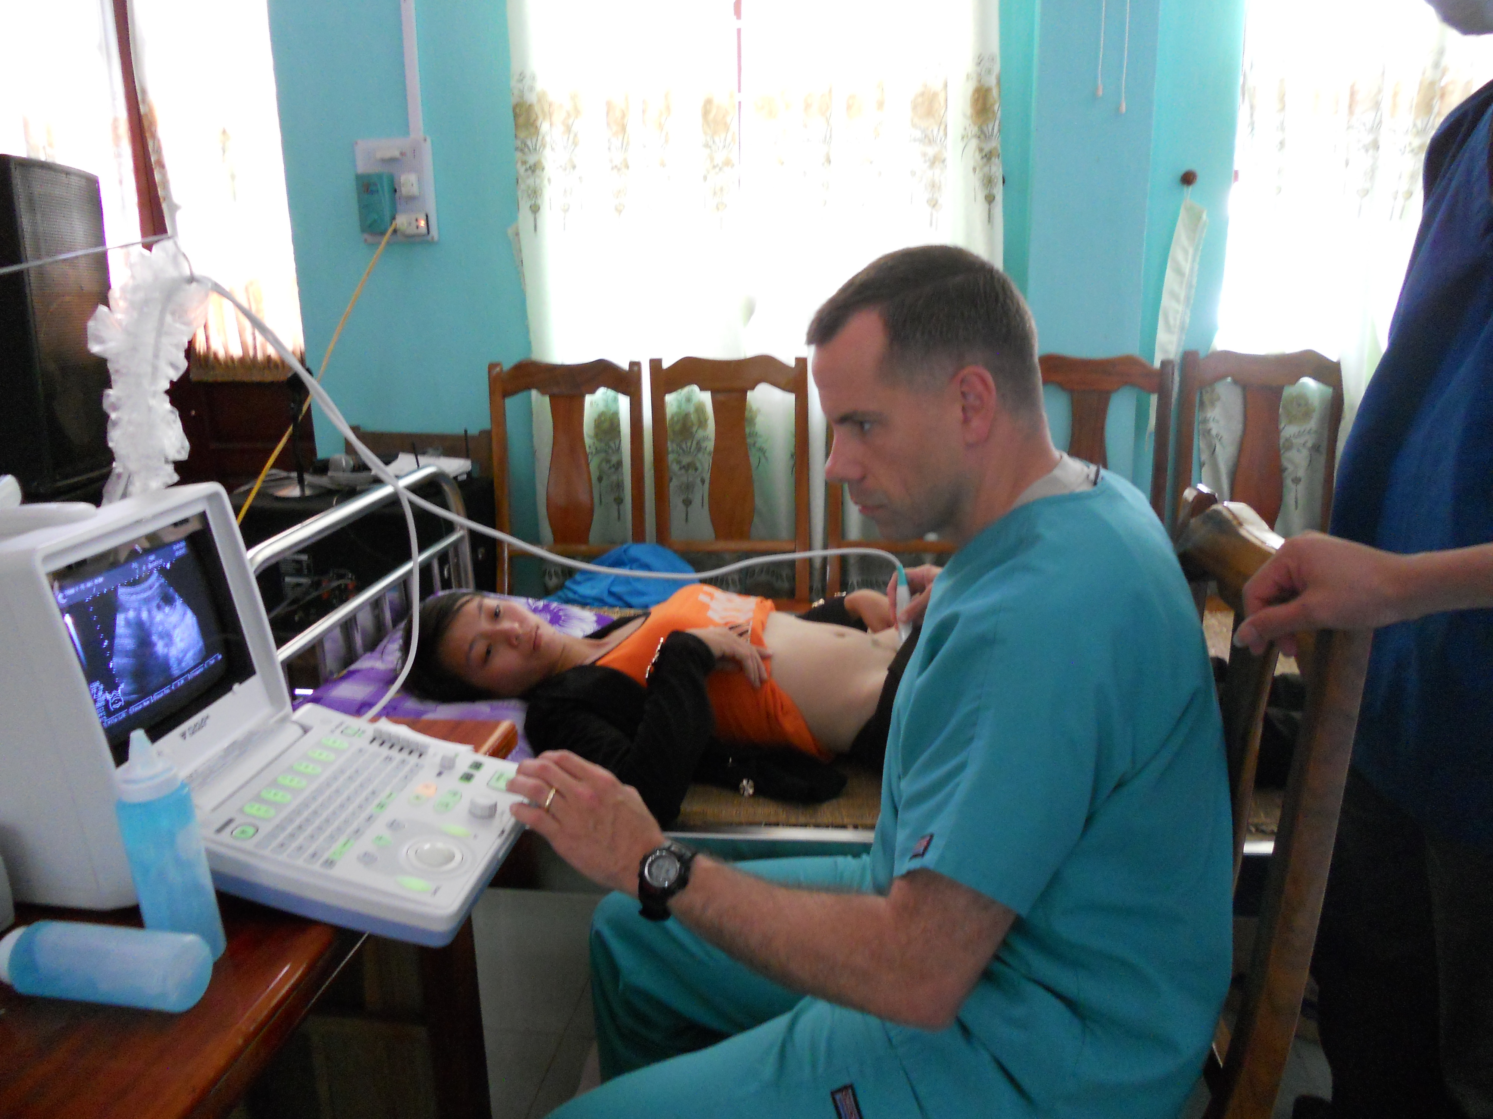
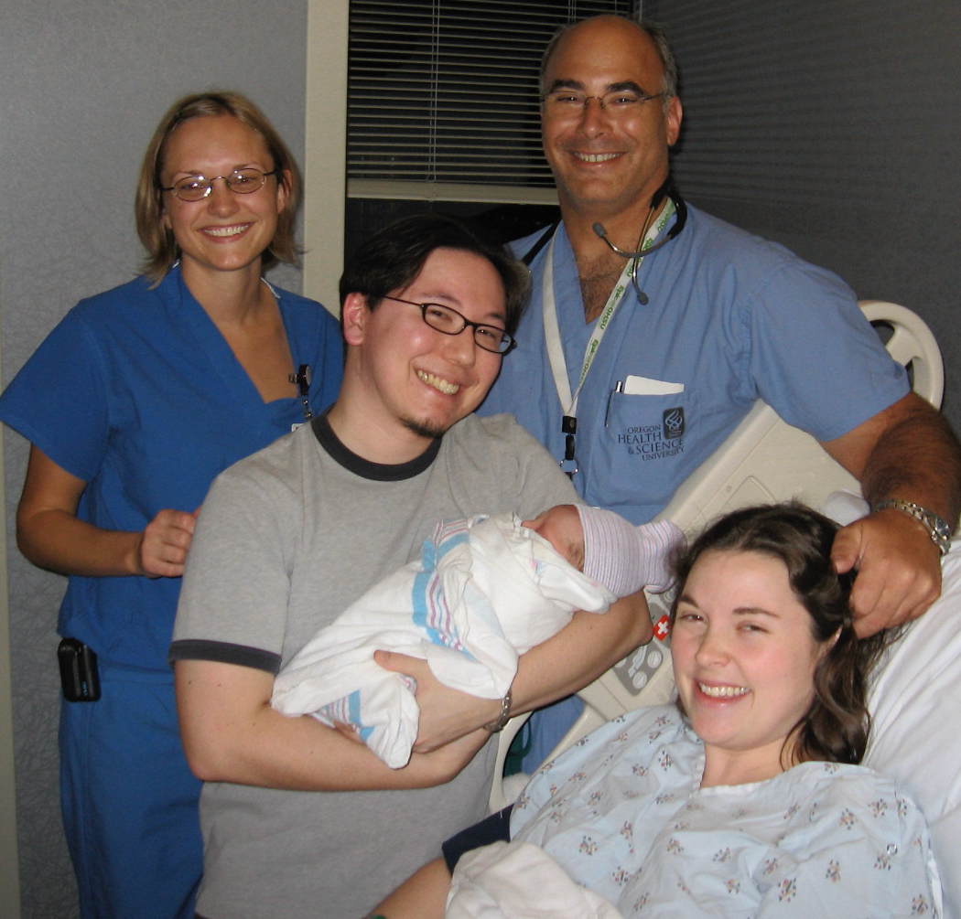
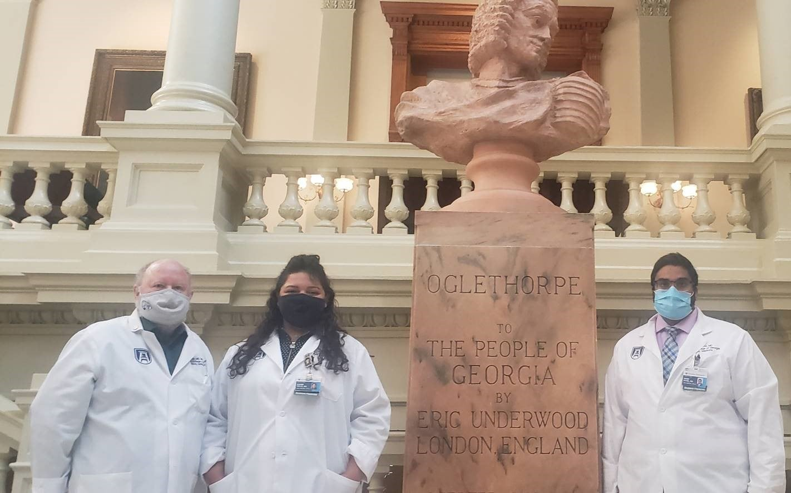
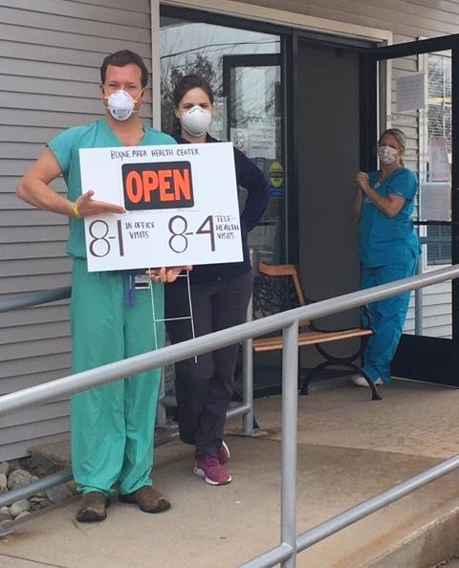
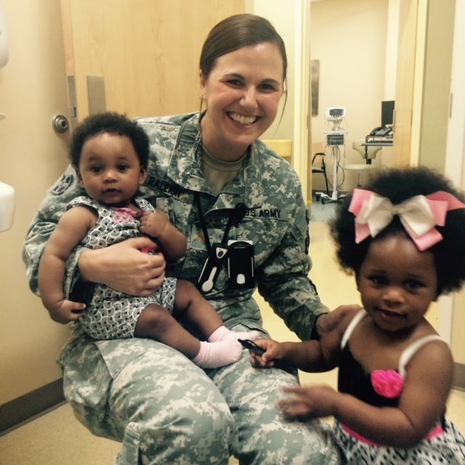
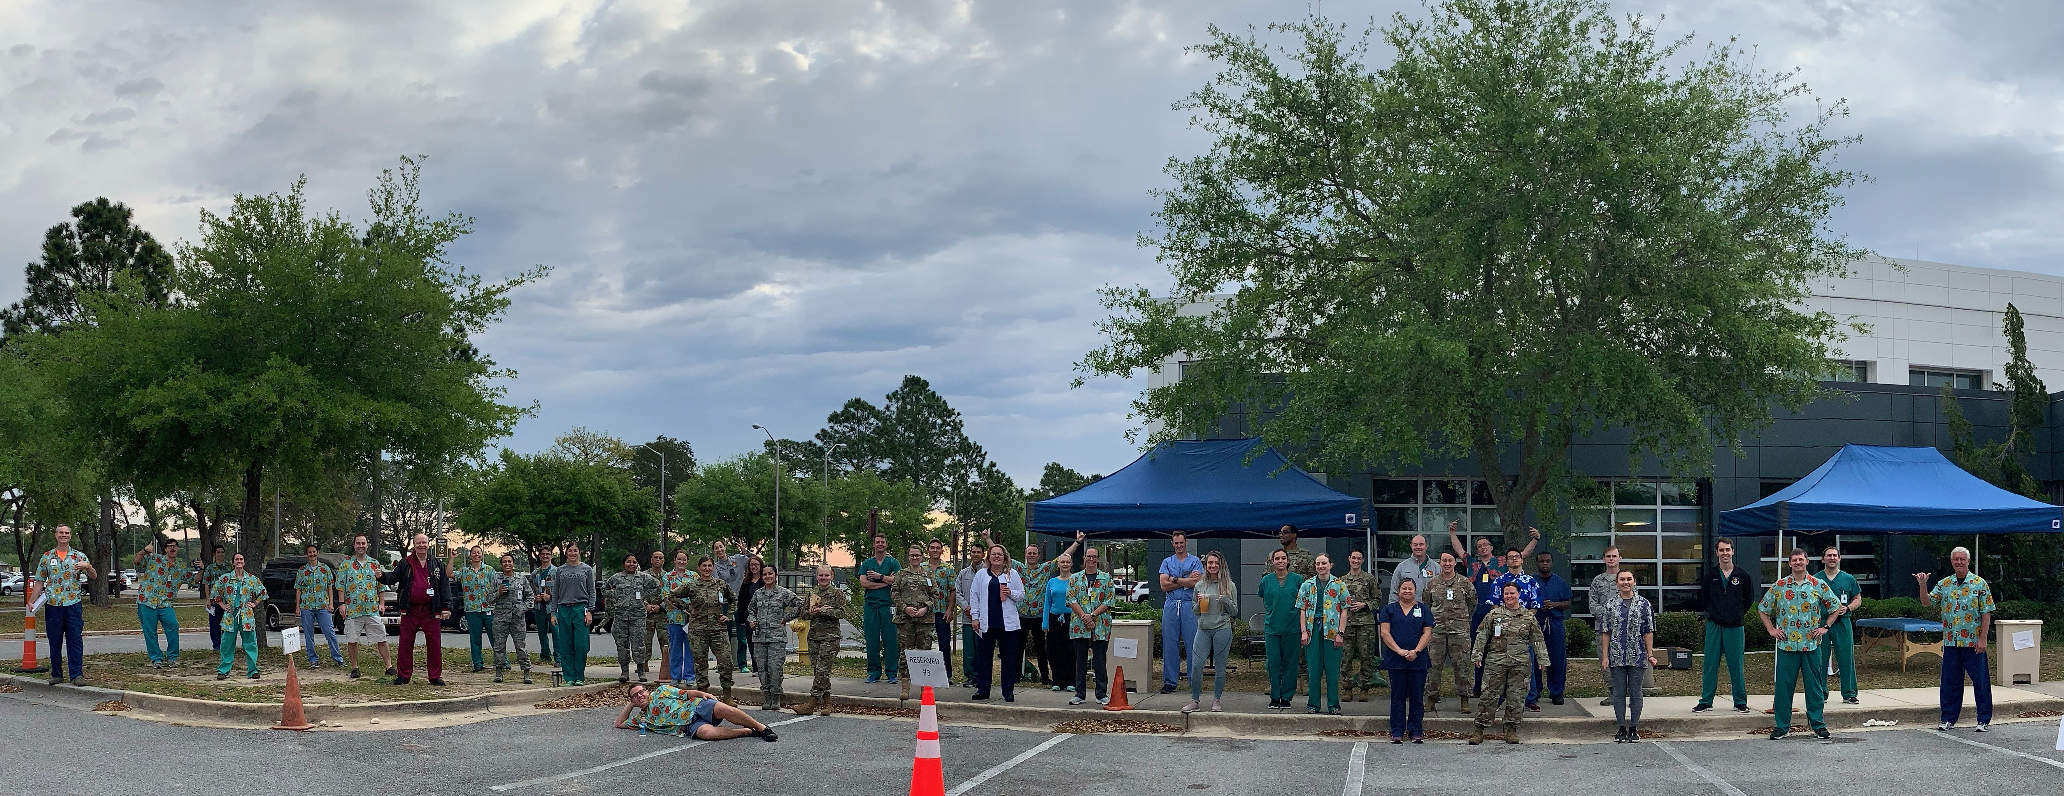

Slide 19
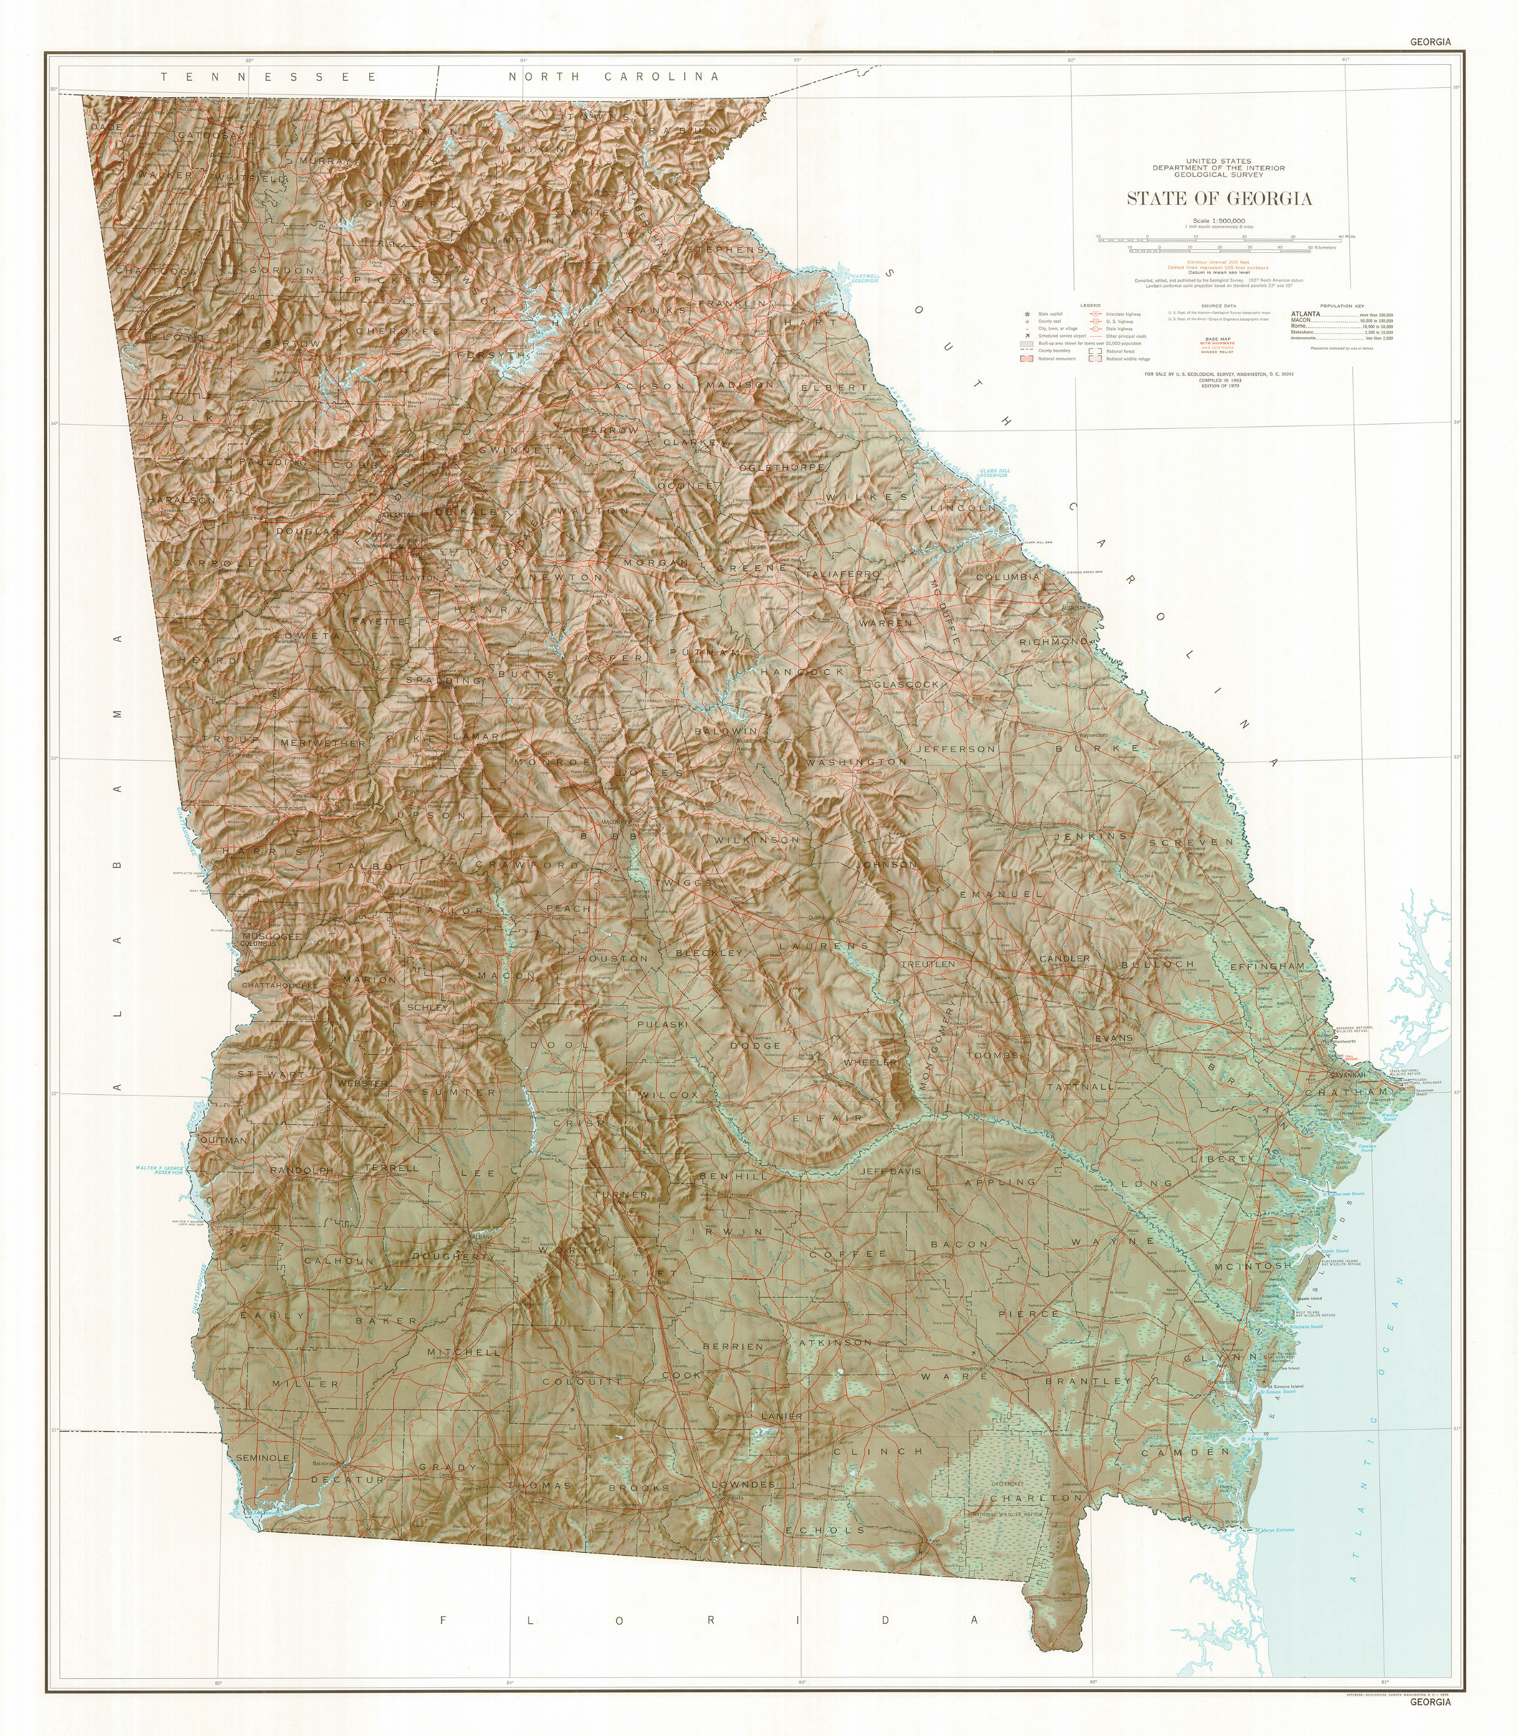
Buckhead
Augusta
Medical College of Georgia
Columbus
Birthplace of NEHI Soda
Claxton
Home of Curtis Hames
Leesburg
Home of Jim Hotz

Slide 20
“Family physicians have no unconditional faith in science, and this marks us as belonging to the counterculture.”
Basic underlying assumptions
“Family physicians have no unconditional faith in science.” - Gayle Stephens
Espoused values
Continuity, comprehensiveness, context
Artifacts
Reserved parking, badged spaces, white coats, fax machines, stethoscope, locked cabinets, smart screens
Schein’s level of culture (1992)

