Slide 1
ADFM LEGISLATIVE AND REGULATORY UPDATE
Nina DeJonghe
Director, Government Relations
February 23, 2023

Slide 2
Today’s Presentation
Who I am – who I represent
How family medicine policy and advocacy work together
Legislative and Regulatory Activities – Substance/Content

Slide 3
Notes:
Some history – many family medicine organizations – big one is American Academy of Family Physicians, several smaller one, more academic based – faculty in medical schools and residencies, program directors of residency programs, Chairs of FM departments in medical schools, and a primary care research organization with plurality of family medicine researchers members. Almost 30 years ago these smaller groups banded together to do two things – set up a legislative committee to develop policy on key issues of importance to their members, hire a lobbyist (me) to devote themselves to these “academic” issues. Very smart to also include the larger organization (AAFP) to make sure family medicine was on the same page in terms of policy and advocacy. Don’t want to say different things on the Hill. STFM became the organizational lead for this effort – and the Chair of this committee is an STFM Board member.
We needed a name for this consortium of groups for advocacy purposes: Council of Academic Family Medicine. Useful for letterhead when submitting letters to the Hill as well as comments on Federal Register notices, etc. Plus – I needed some way to answer the phone in less than a full 15 seconds…

Slide 4
How Does Organized Family Medicine Work Together?
North American Primary Care Research Group
Society of Teachers of Family Medicine CAFM
Association of Family Medicine Residency Directors
Association of Departments of Family Medicine
American Academy of Family Physicians (AAFP)
American Board of Family Medicine (ABFM)
CAFM + AAFP + ABFM = AFMAC
Notes:
Alphabet soup – four CAFM organizations, plus the AAFP, and recently the American Board of Family Medicine – the credentialing body for family doctors, joined. All make up the legislative committee I mentioned before – called the Academic Family Medicine Advocacy Committee – or AFMAC -- no jokes please about quacking ducks!!

Slide 5
Academic Family Medicine Advocacy Committee - AFMAC
STFM
ABFM
AFMRD
AAFP
ADFM
NAPCRG
Notes:
Just another way to visualize the legislative policy committee. But why organize the “family of family medicine” this way? Why hire a separate lobbyist from AAFP? Because we can pay more attention to a smaller number of academic family medicine issues and even influence the larger organization. Our concerns or issues can be fairly esoteric, specialized, and even considered minutiae in the larger health care policy debates. This way we can gain attention for our issues and concerns.

Slide 6
Year to Date Wins: Rural Physician Workforce Production Act of 2023
Rural GME: H.R. 834
Introduction in the House: H.R. 834
Reps. Diana Harshbarger (R-TN), Kim Schrier (D-WA).
Identified NEW House Democratic Lead (Committee of Jurisdiction: E&C).
Currently 4 cosponsors 2(D) 2(R).
Rural GME: S. 230
Introduction in the Senate: S. 230
Sens. Jon Tester (D-MT), John Barrasso (R-WY).
Currently 10 cosponsors 6 (R) 3 (D) 1 (I).

Slide 7
Year to Date Wins
Consolidated Appropriations Act, 2023 Final Rule
Positive changes due to joint CAFM/AAFP comments and advocacy.
Primary Care Research Center: AHRQ FY2023 final appropriations
$2 m for AHRQ Appropriations directed to the Center.
Notes:
Both House Leads on Rural GME are on Energy and Commerce ctme; #2’s we hope to have on Ways and Means Ctme
Final Rule wins: expand to count all training sites, not just hospital or provider-based; allow exemption from rolling avg.;
Rural Physician Workforce Production Act of 2021
Senate – more republicans; house more dems

Slide 8
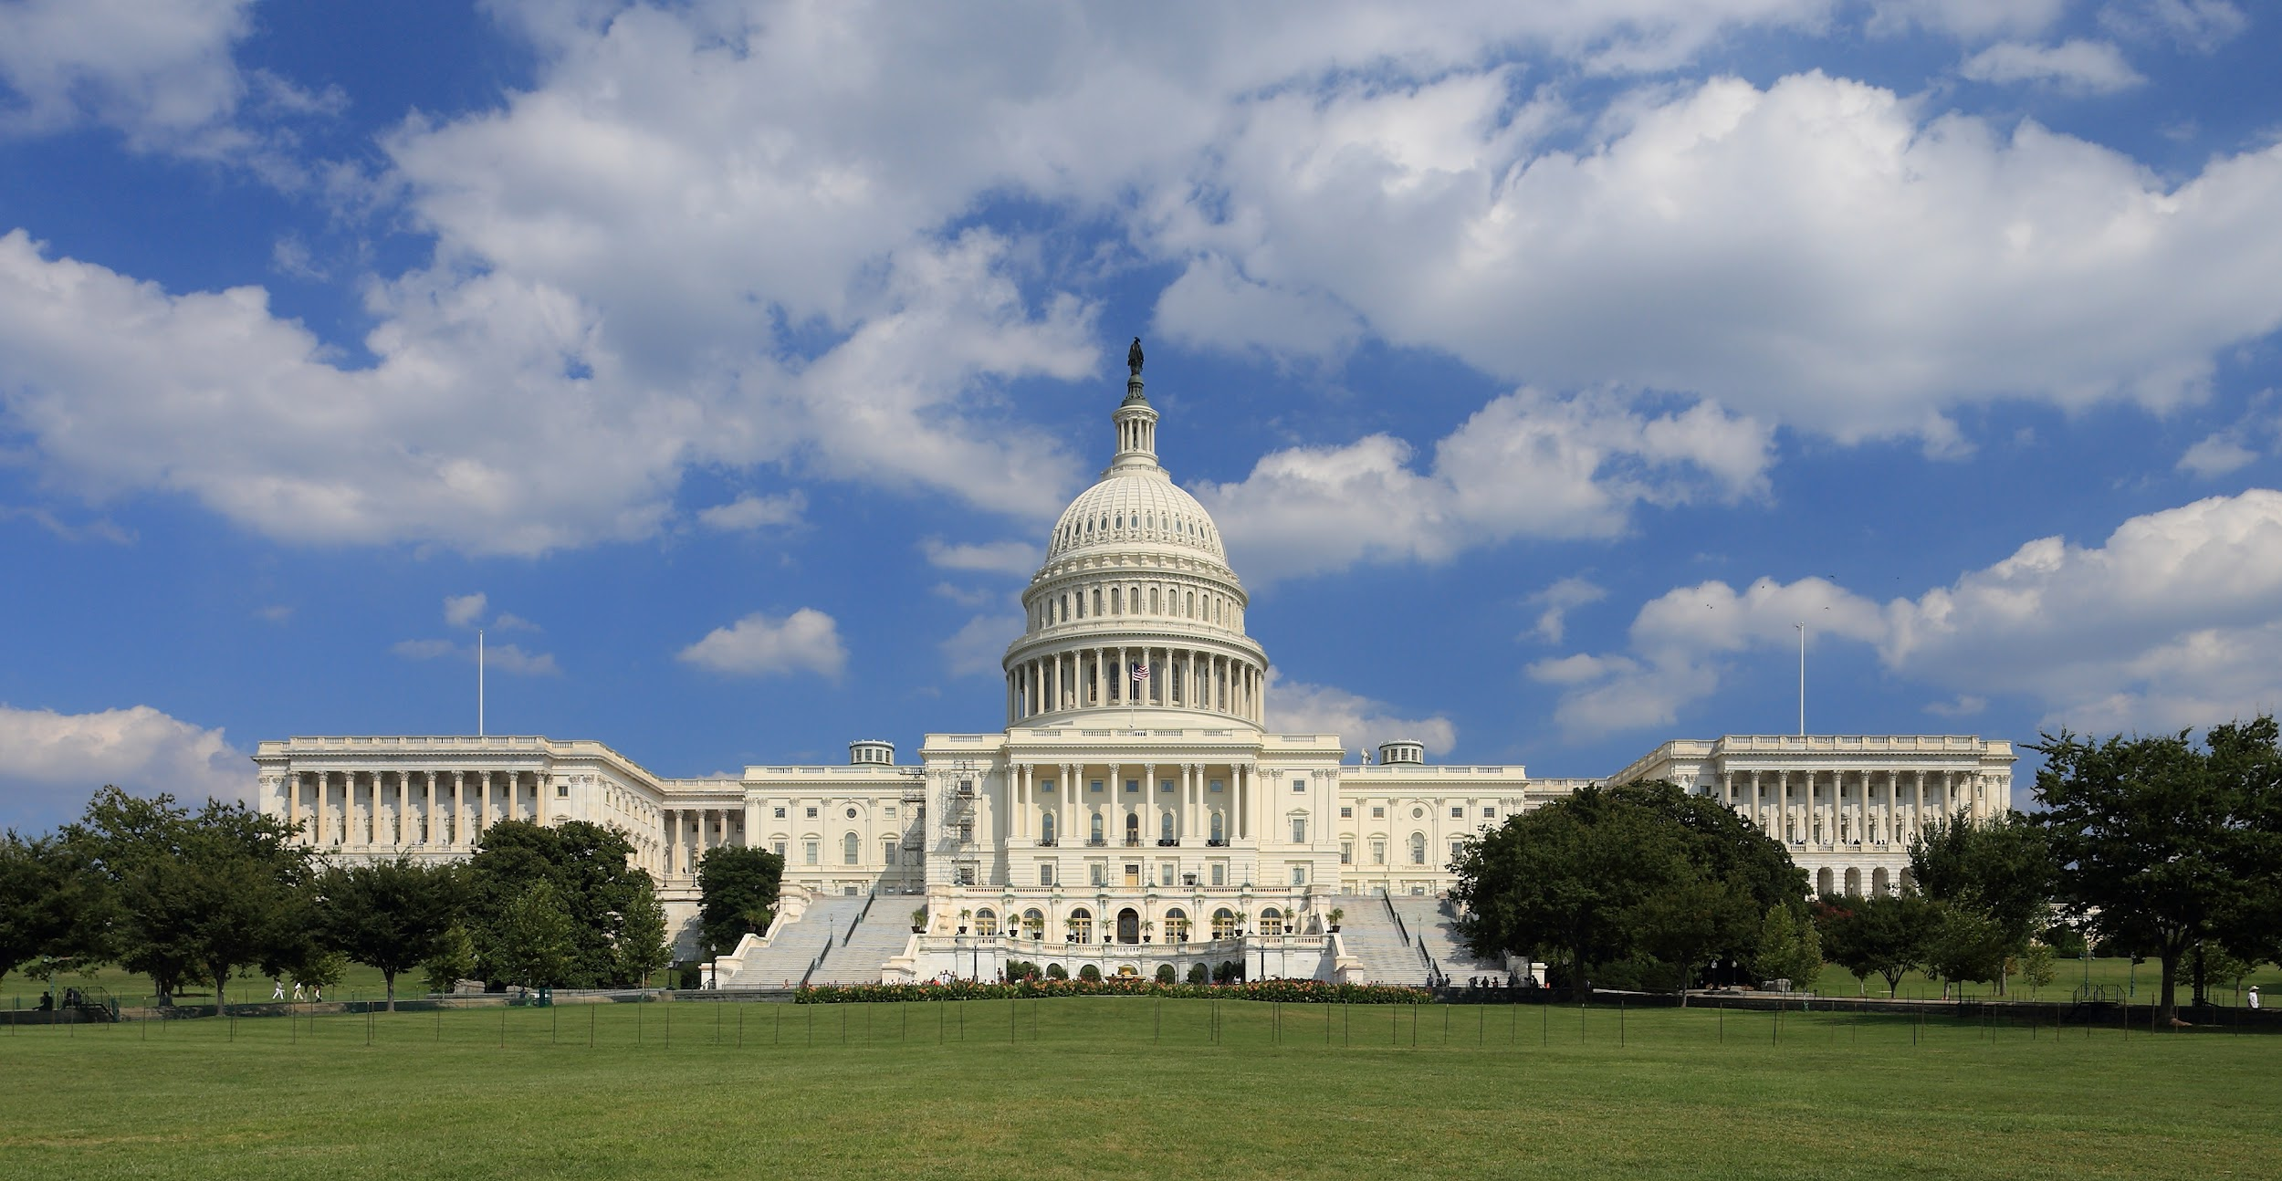
Congress Leans Into Rural Workforce Issues:

Slide 9
Recap: CAA 2021
The CAA 2021 was the first time that Congress included workforce goals in Medicare GME*
Including direction to increase service/training to underserved
Over cap hospitals that want new FTE’s must add new residents, not replace who pays for existing ones.
Requires two GAO reports on impact of GME provisions.
Build Back Better expands on this direction- Passed the House
Requires reporting similar to THC GME in terms of practice patterns – specialty, service in HPSAs or rural.
Directs new slots to identified needs such as rural, etc.
New program to increase diversity among medical students/physician workforce.
Includes our “rural” definition, to be more inclusive.
Notes:
THCGME has always had reporting requirements and is aimed specifically toward primary care and community-based training

Slide 10
Last Week in Congress
The Senate HELP Committee held a hearing on February 16, 2023
Sen. Bernie Sanders (D-VT), Chairman of Senate Health Committee.
The committee addressed several workforce issues, GME was a prevalent discussion item.
Evident that Congress is looking for solutions to fix issues within rural areas across the country.
Covid-19 has altered congressional priorities in terms of healthcare needs. The pandemic has forced Congress to be more mindful and strategic as they work on solutions to serve vulnerable communities and the workforce.

Slide 11
Last week in Congress cont…
Sen. Roger Marshall (R-KS): “Increasing the workforce pipeline and improving the number of students who remain in rural communities after they graduate could both be accomplished by strengthening community college training programs for certain provider types.”
Senate legislators and experts, including Sen. Sanders said, “Congress should continue to explore increases in the number of Medicare Graduate Medical Education slots”.
Public Health Emergency ends May 11th, 2023.

Slide 12
CONSOLIDATED APPROPRIATIONS ACT, 2023 (CAA) REGULATORY ADVOCACY EFFORTS

Slide 13
GME Medicare Slots
200 additional GME Medicare slots.
1/3 of slots went to primary care specialties.
60 of the 200 new Medicare GME slots distributed went to family medicine residencies serving HPSAs.
5 residency programs (located in rural areas) received 12 GME slots.
Applications for second round of GME slots is due March 31st.
Notes:
The 2021 CAA, gave 1000 GME slots, the new CAA 2023 gave an additional 200 slots.

Slide 14
Title VII: PCTE &
AHRQ: Center for Primary Care Research
Title VII: Primary Care Training Enhancement (PCTE);
The PCTE program received a $1 m increase.
Dedicated to provide training for primary care health professionals to screen, intervene, and refer patients to treatment for the severe mental illness of eating disorders.
Agency for Healthcare Research and Quality’s Center for Primary Care Research (AHRQ):
Although we had success in both the House and Senate bills gaining $5 million for the Center (up from $22 million in FY22), the final omnibus bill only includes the $2 m.
This is disappointing; yet a victory because CAFM is the reason the center received $2 m.
Notes:
The 2021 CAA, gave 1000 GME slots, the new CAA 2023 gave an additional 200 slots.

Slide 15
Rural Health Program, CAA 2023
The bill appropriates $352.4 million, an increase of $21 million above the fiscal year 2022 enacted level, for all Rural Health Programs.
As part of this, the rural residency development program received an increase of 2 million to the $12.5 million.
The Rural Communities Opioid Response Program received an increase of $10 million totalling $145 million.
Notes:
The 2021 CAA, gave 1000 GME slots, the new CAA 2023 gave an additional 200 slots.

Slide 16
What’s on our agenda in the 118th Congress?
Appropriations - Deadlines are fast approaching
-AHRQ Center for Primary Care Research
-PCTE Title VII departmental grants (report language)
Rural GME legislation- gain cosponsors in both chambers.
GME funding in spending packages.
Teaching Health Center Permanence
Continue working with the AATHC and coalition partners to elevate issue of THC funding cliff.

Slide 17
AHRQ Center for Primary Care Research: Appropriations
Increase from $2 million to $5 million
Notes:
We just met w/ the Senate to discuss increasing appropriations. CAFM, and my predecessor worked incredibly hard to get $5 million included in both the House and Senate bills, but unfortunately the final bill only included 2 million.

Slide 18
Title VII - PCTE
Increase by $10 m – to $59 m
Funding for Departments
Goal is to increase student choice
PCTE program no longer funds medical schools (HRSA retired specific measure 6.I.C.25)

Slide 19
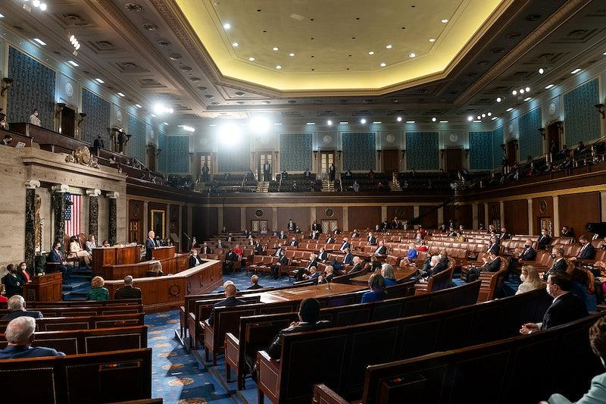
Rural GME/ DOC Act

Slide 20
Rural Physician Workforce Production Act fixes:
The current funding system disadvantages rural GME
Critical Access Hospitals and Sole Community Hospitals eligible for little Graduate Medical Education (GME) reimbursement. Generally ≈ 1/3 of what urban hospitals are paid.
CAHs can only be reimbursed for direct costs.
Many factors can result in a low Medicare share at rural hospitals:
Maternity care (no Medicare)
Lower Surgical volume (esp. Orthopedics) for Medicare age patients
Many rural hospitals have accidental low Per-Resident Amounts (PRAs) and/or low caps from prior elective resident rotations.
**Information used on this slide originates from Dr. Lou Sanner (Univ. of Wisconsin) and Hope Wittenberg’s Rural Physician Workforce Production Act Advocacy PPT.

Slide 21
Stakeholder Support: Rural GME
American Academy of Family Physicians
American Association of Colleges of Osteopathic Medicine
American College of Osteopathic Family Physicians
American Osteopathic Association
Council of Academic Family Medicine
GME Initiative
National Rural Health Association

Slide 22
Teaching Health Centers
Twin advocacy efforts needed in the 118th Congress:
Re-introduce/pass the “Doc Act” to provide permanence.
Expand funding and reauthorize to cover new programs/FTEs.
Strategy:
CAFM in partnership with the American Association of Teaching Health Centers (AATHC) and its coalition partners are proposing a 3 year proposal to adequately fund THC’s.
Notes:
Funding Cliff approaching September 2023.
Unfortunately, there were no provisions relating to THCGME in the 2023 CAA

Slide 23
THC funding
ARP and Reauthorized Funding Ends
March 2021
Dec 2020
FY2022 Budget Reconciliation
American Rescue Plan adds $330 m for same time period – through Sept 2023
BBB funding continues
Reauthorized through Sept 2023
? 3.37 B for FY2022, but use until expended
Oct 1, 2021
Oct 1, 2022
Sept 30, 2023
FY
FY 2022 Beg
FY 2023 Beg
FY 2024 Beg
Notes:
If nothing else happens – reauthorization or BBB provisions THC funding ends Sept 30, 2023

Slide 24
DOC Act
To provide: Teaching Health Center Permanence
Over $6 billion
Only Democratic cosponsors
Bill Leads: (117th Congress)
Senator Patty Murray (D-WA) S.1958
Representative Frank Pallone (D-NJ) H.R. 3671

Slide 25
Primary Care Funding Opportunities/ Rural GME Residency Slots
AHRQ Small Research Projects to Advance the Science of Primary Care (R03):
Due: June 16, 2023:
“ Supports small research projects that advance the understanding of the role and capacity of primary care to increase the value and quality of care and improve patient outcomes and population health by delivering person-centered care."
Medicare GME Residency slots available (second round of allocations):
Due: March 31, 2023:
“CMS will prioritize training sites in HPSA’s and tribal facilities located outside of a HPSA.”

